Slide 1
Design and Analysis of Algorithms
Rahul Jain

Slide 2
Lecturer : RAHUL JAIN
Office : S15-04-01
Email: rahul@comp.nus.edu.sg
Phone: 65168826 (off)
Tutors :
ERICK PURWANTO (erickp@comp.nus.edu.sg)
ZHANG JIANGWEI (jiangwei@nus.edu.sg)
Prerequisites : (CS2010 or its equivalent) and
(CS1231 or MA1100)
Book :
Title : Algorithms
Authors : R. Johnsonbaugh and M. Schaefer
Publication : Pearson Prentice Hall, 2004
(International Edition)
Other reference books mentioned in the course home page : http://www.comp.nus.edu.sg/~rahul/CS3230.html
Grading :
50 marks for final exam
35 marks for midterm exam
10 marks for two quizzes (5 marks each)
5 marks for tutorial participation
Tutorials : Start next week. Information available at course home page
Acknowledgment : We thank Prof. Sanjay Jain for sharing with us his course material.

Slide 3
Regarding CS3230R
According to my information current implementation of the R-modules is as follows:
Discuss with the lecturer that you would like to do the R-module.
The lecturer will decide whether it is appropriate for you after teaching you for a period (around middle of semester or end of semester).
Start work on it after the lecturer has decided (middle of the current semester or at the next semester). The course will be registered only in the following semester.

Slide 4
What we cover in the course
Sorting/Searching/Selection
A lower bound for the sorting problem
Counting sort and Radix sort
Topological sort of graphs
Divide and Conquer
A Tiling problem
Strassen’s Matrix Product Algorithm
Finding closest pair of points on the plane
Greedy Algorithms
Kruskal’s algorithm for Minimum Spanning Tree
Prim’s algorithm for Minimum Spanning Tree
Dijkstra’s algorithm for finding shortest path between a pair of points in a graph
Huffman codes
The continuous Knapsack problem
Dynamic Programming
Computing Fibonacci numbers
Coin changing
The algorithm of Floyd and Warshall

Slide 5
What we cover in the course
P v/s NP
Polynomial time, Non-deterministic algorithms, NP
Reducibility and NP-completeness, NP complete problems
How to deal with NP hard problems
Brute force
Randomness
Approximation
Parameterization
Heuristics
Assume familiarity with :
Basic data structures like Stacks, Queues, Linked lists, Arrays, Binary Trees, Binary Heaps,
Basic sorting algorithms like Heap sort
Basic search algorithms like Depth-First search, Breadth-First search
Basic mathematical concepts like Sets, Mathematical Induction, Graphs, Trees, Logarithm

Slide 6
What is an Algorithm ?
Abū ʿAbdallāh Muḥammad ibn Mūsā al-Khwārizmī (c. 780 – c. 850)
A Persian mathematician, astronomer and geographer.
Properties :
Input
Output
Precision
Determinism
(exceptions: randomization, quantum etc.)
Finiteness
Correctness
Generality
Pseudocode : Has precision, structure, universality. It is unambiguous, clear enough (not too rigorous, will not be concerned with semi-colons, uppercase, lowercase etc.)
Analysis :
Correctness
Termination
Time analysis
Space analysis

Slide 7
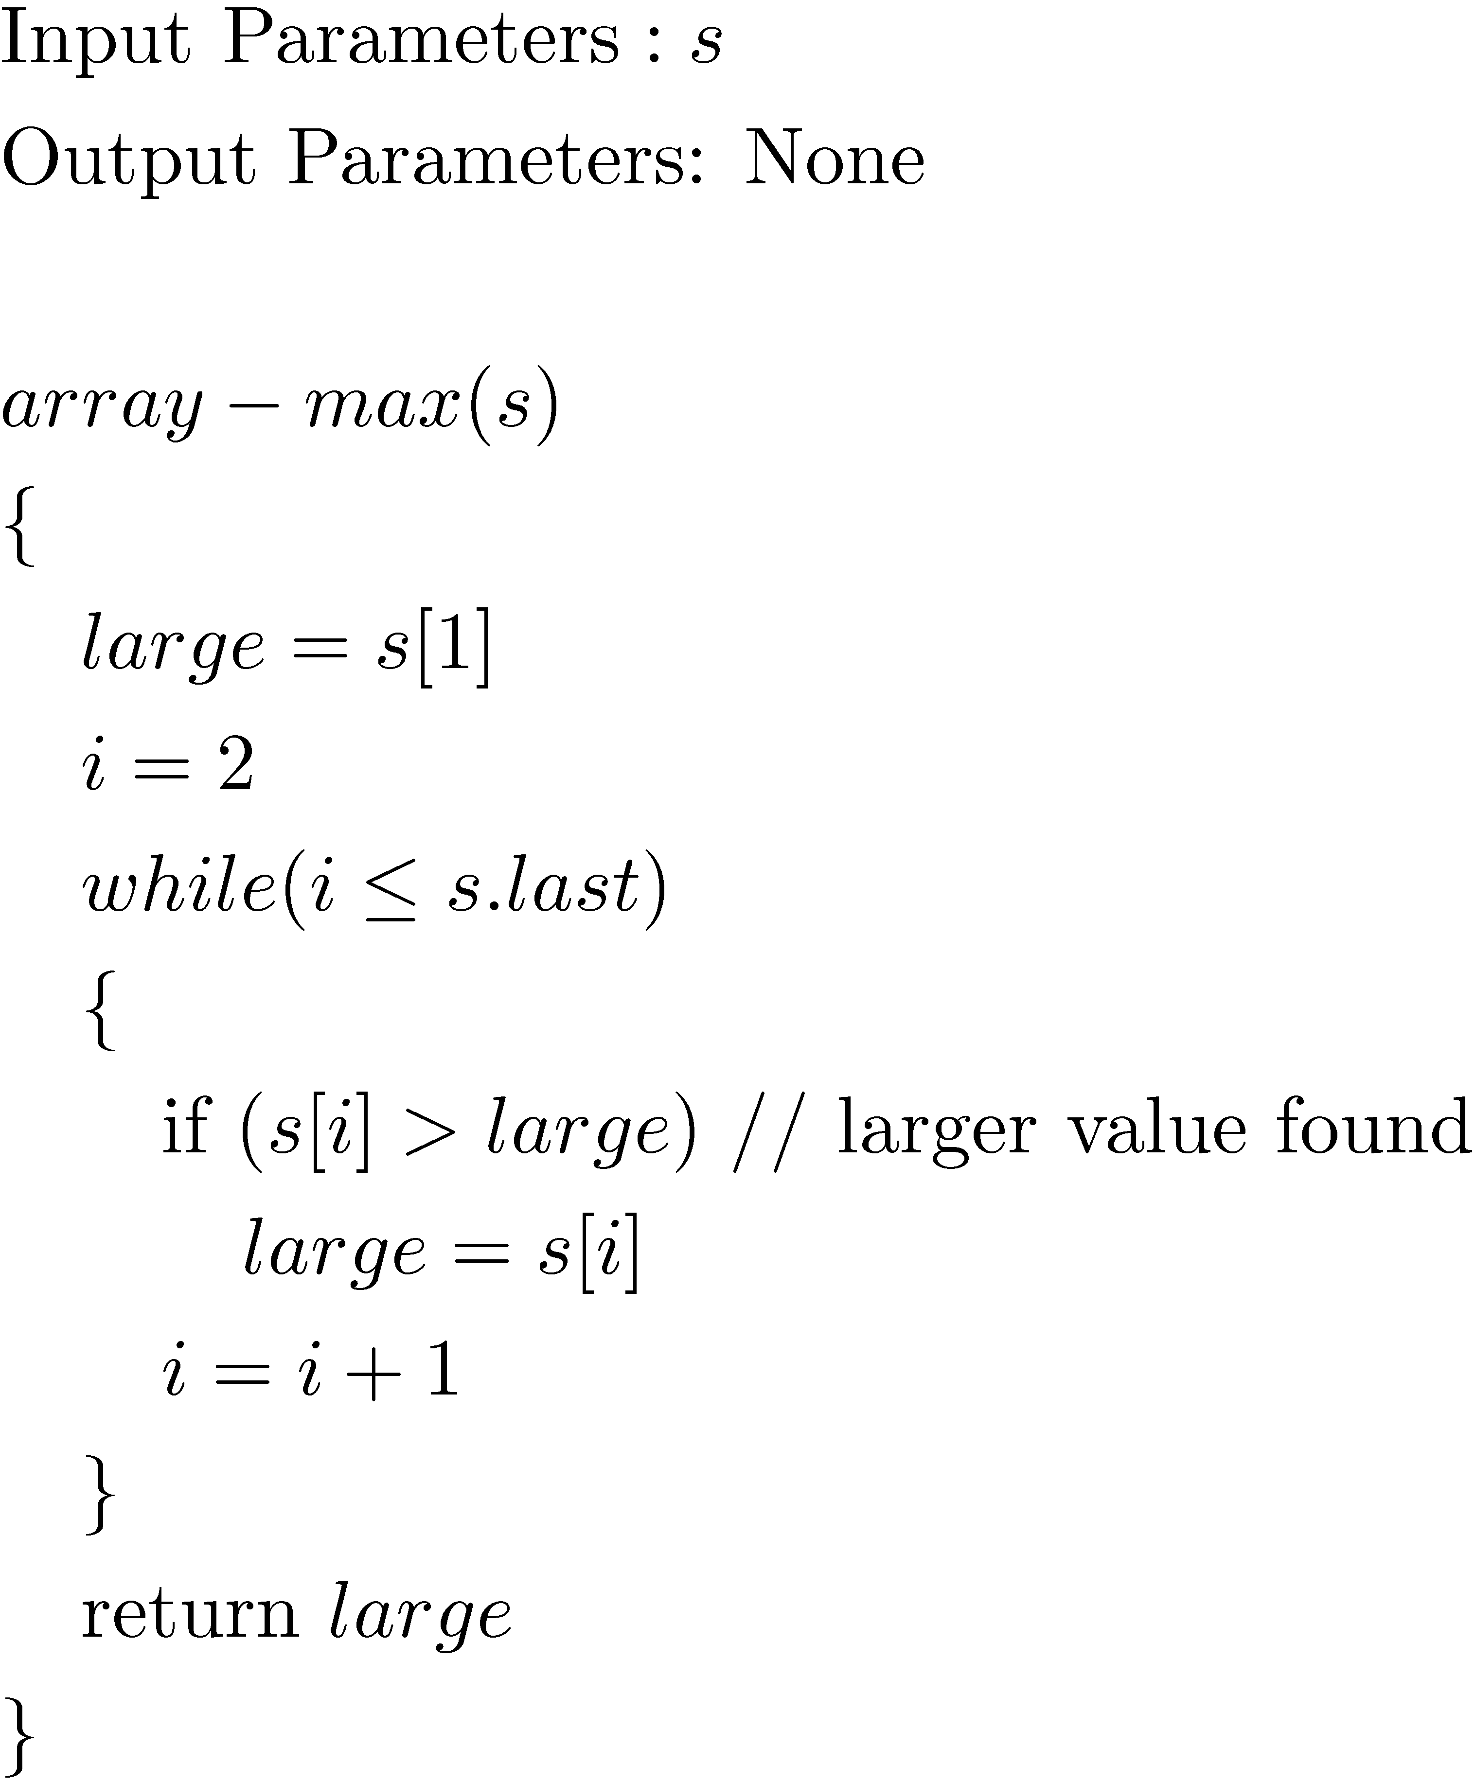
Pseudocode - Example
Algorithm for finding maximum element in an array
-----------------------------------------
if (condition)
action 1
else
action 2
-----------------------------------------
do
{
action
} while (condition)
----------------------------------------
for var = init to limit
action
-----------------------------------------
for var = init downto limit
action
-----------------------------------------

Slide 8
Algorithm analysis Worst case, Average case
Worst case analysis :
t(n) = Maximum units of time taken by the algorithm to terminate for an input of size n.
Average case analysis :
t(n) = the average units of time taken by the algorithm to terminate for an input of size n.
Similar analysis can also be done for space required by the algorithm.
The worst case and average case times of the algorithm on an array of size n are each
constant * (n-1)
since the while loop is always executed (n-1) times, and every other operation takes constant time.

Slide 9
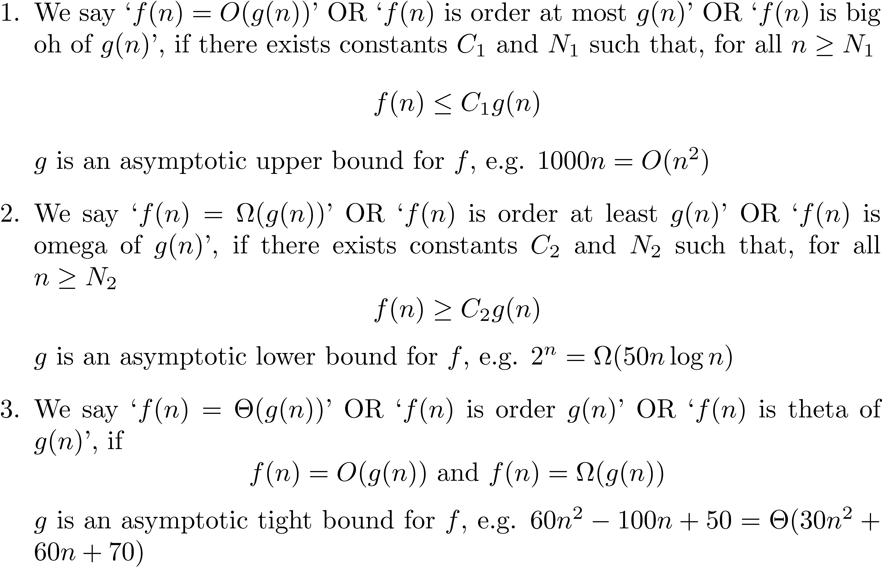
Big Oh, Omega and Theta

Slide 10
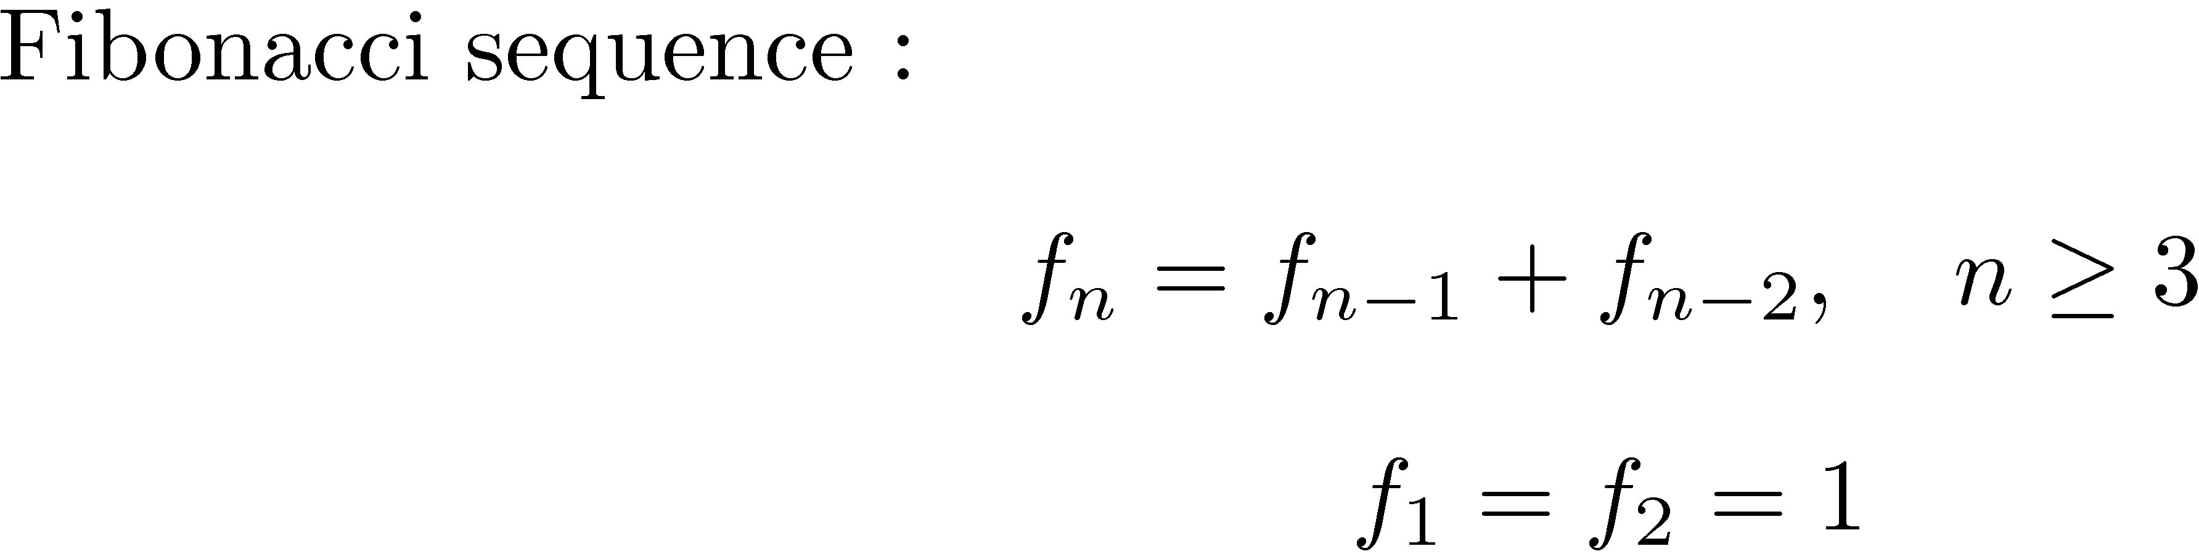
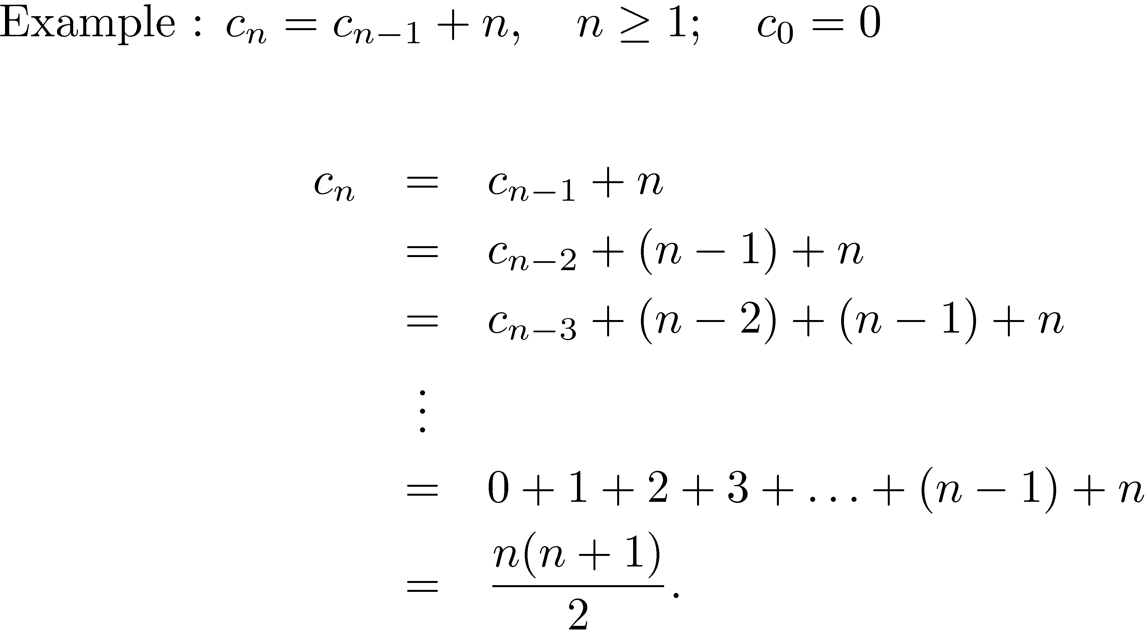
Recurrence Relations

Slide 11
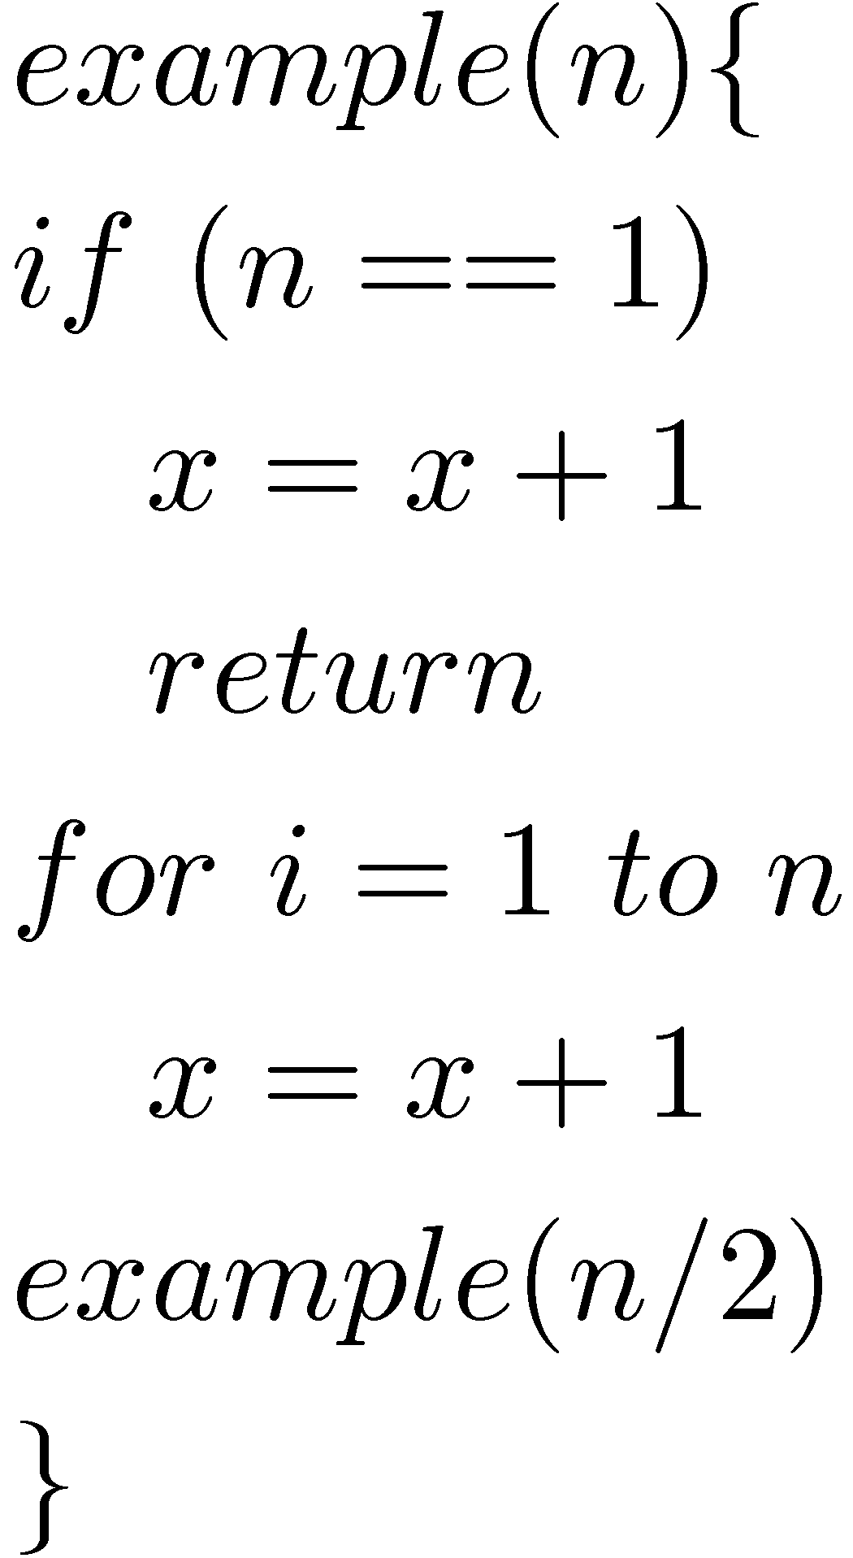
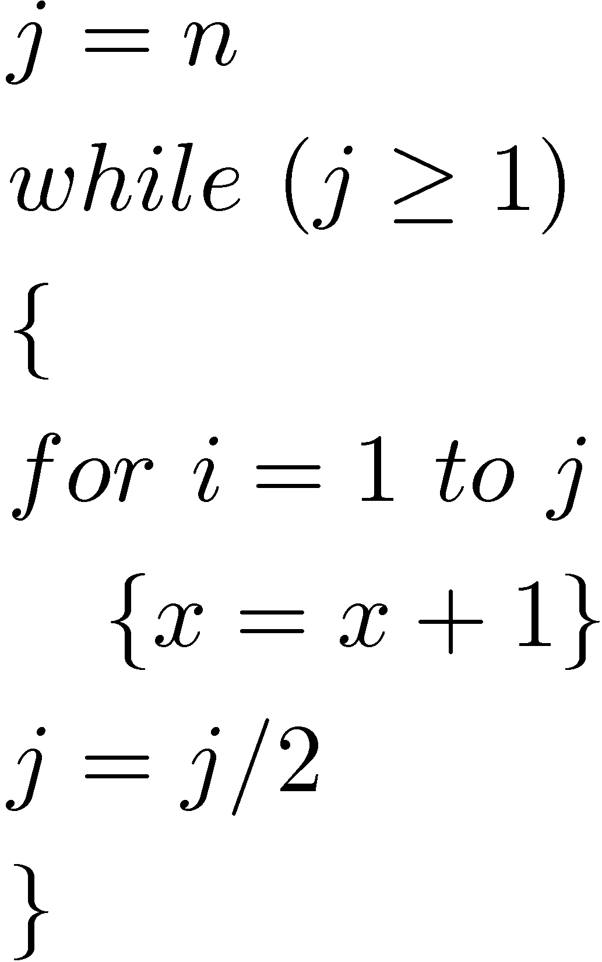
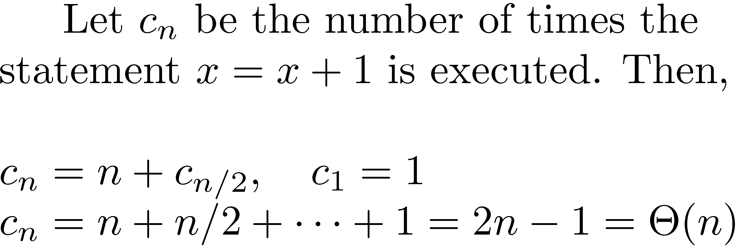
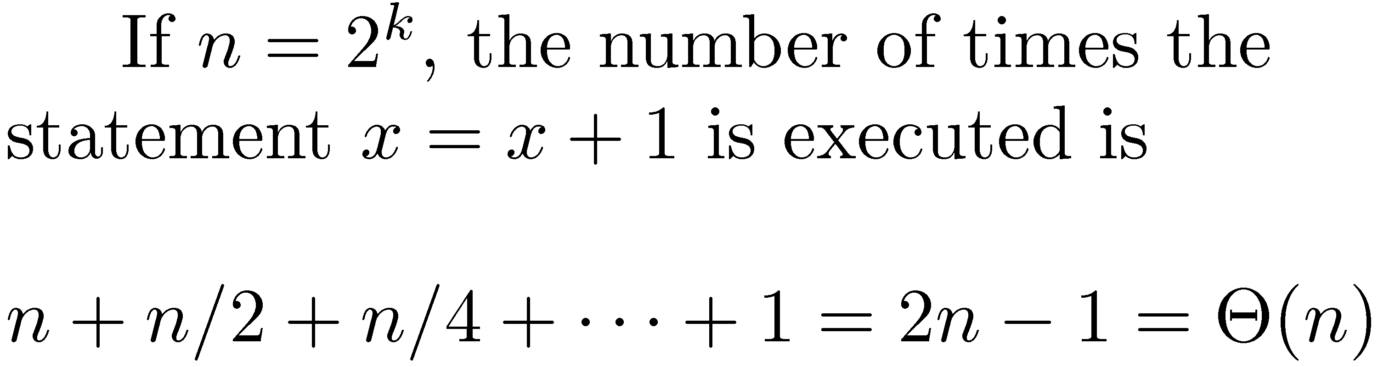
Examples

Slide 12
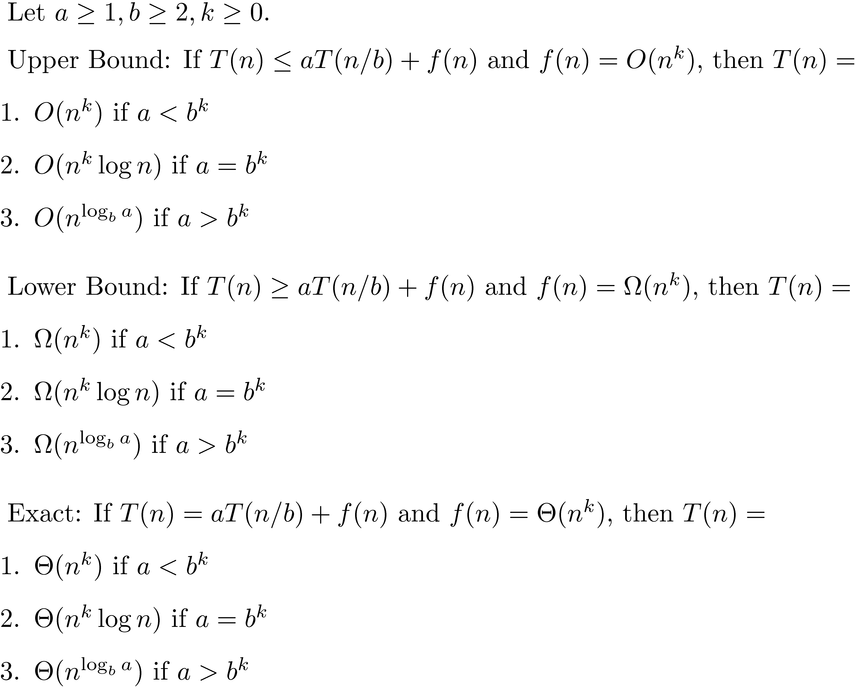
Main Recurrence Theorem

Slide 13
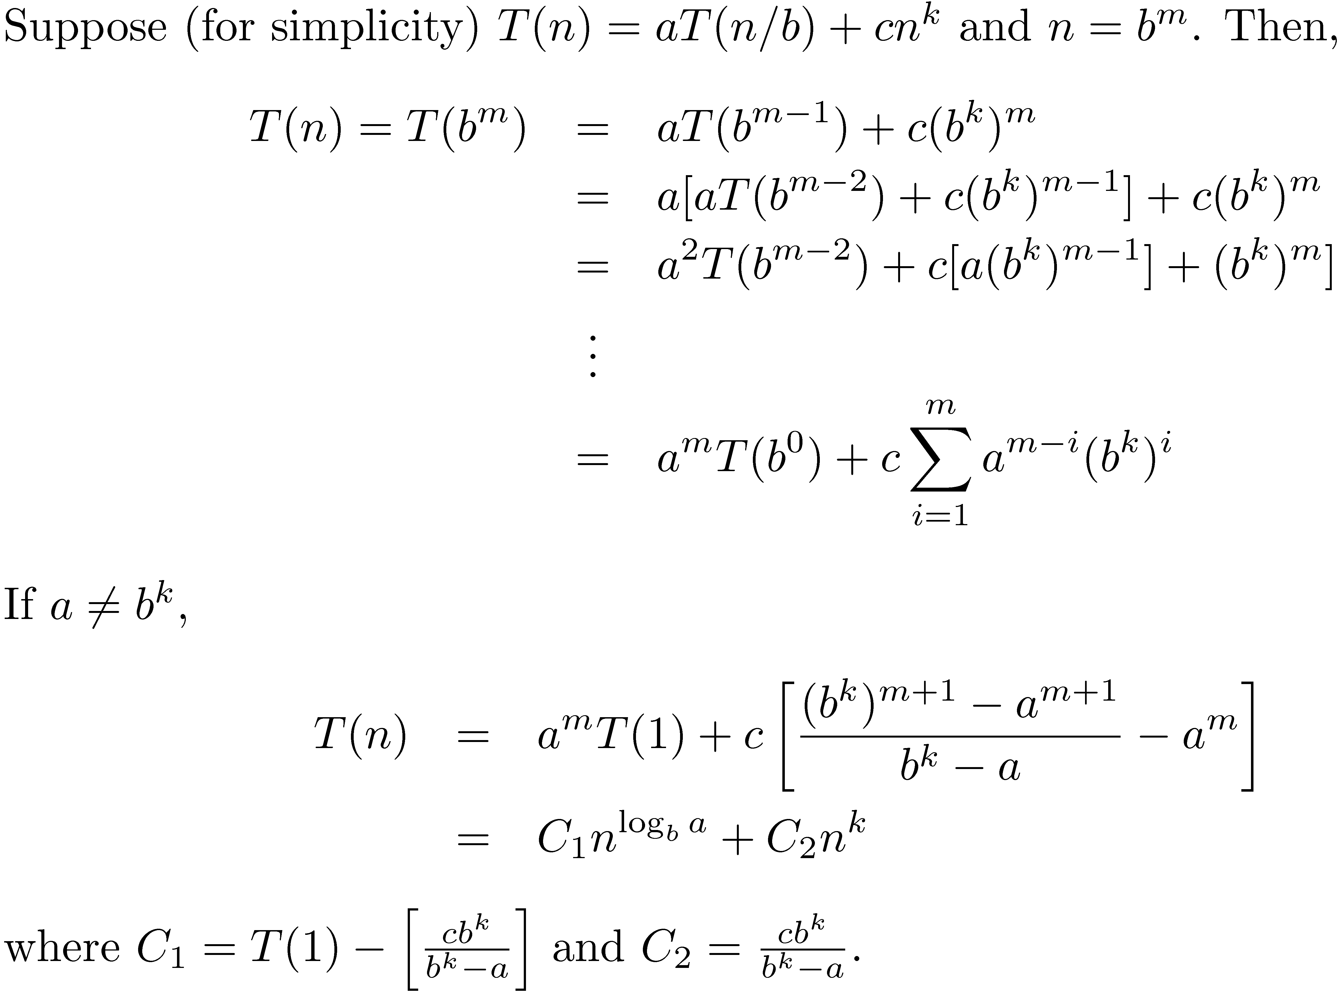
Proof Idea

Slide 14
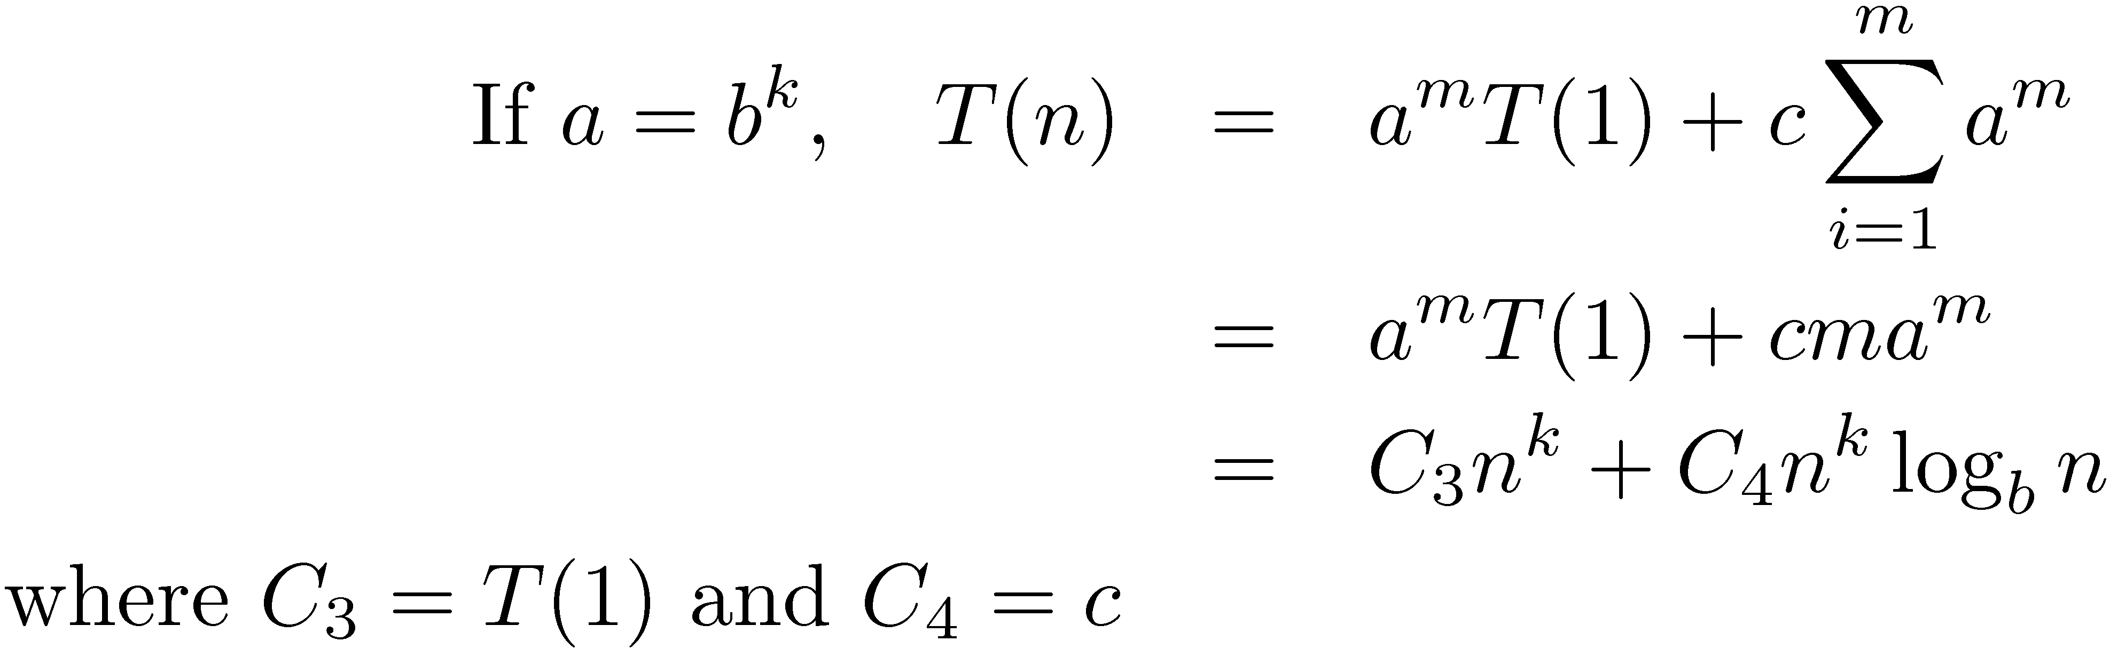
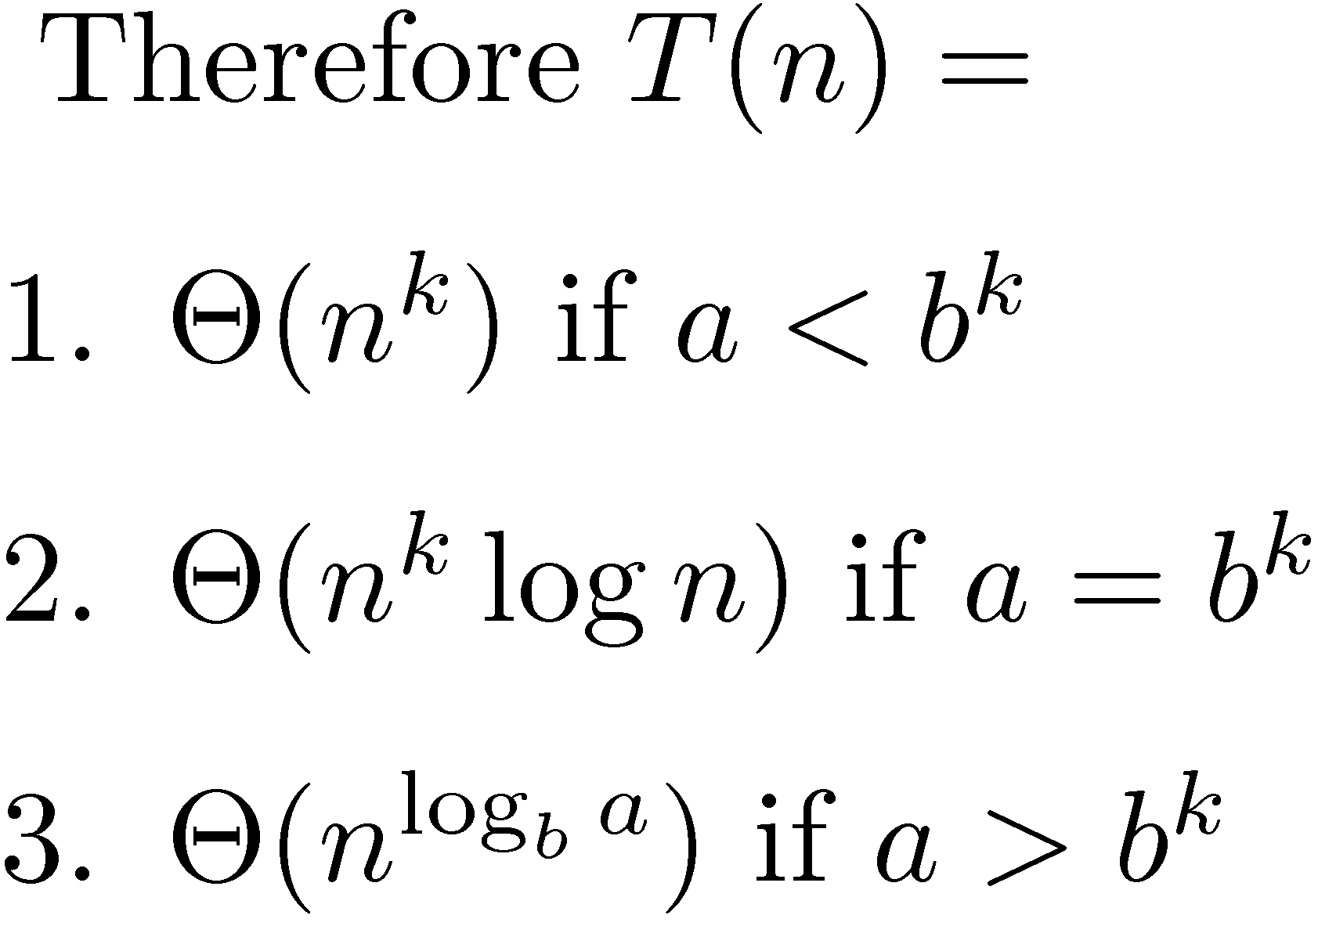
Proof Idea contd.

Slide 15
With today’s lecture and the material covered in pre-requisite courses we have covered Chapters 1, 2, 3, 4 from the book.

Slide 16
Divide and Conquer

Slide 17
Divide and Conquer
If the problem is small solve it directly.
If the problem is big, divide it into subproblems. Solve the subproblems, again using divide and conquer.
Combine the solutions of the subproblem to get the solution of the original problem.

Slide 18
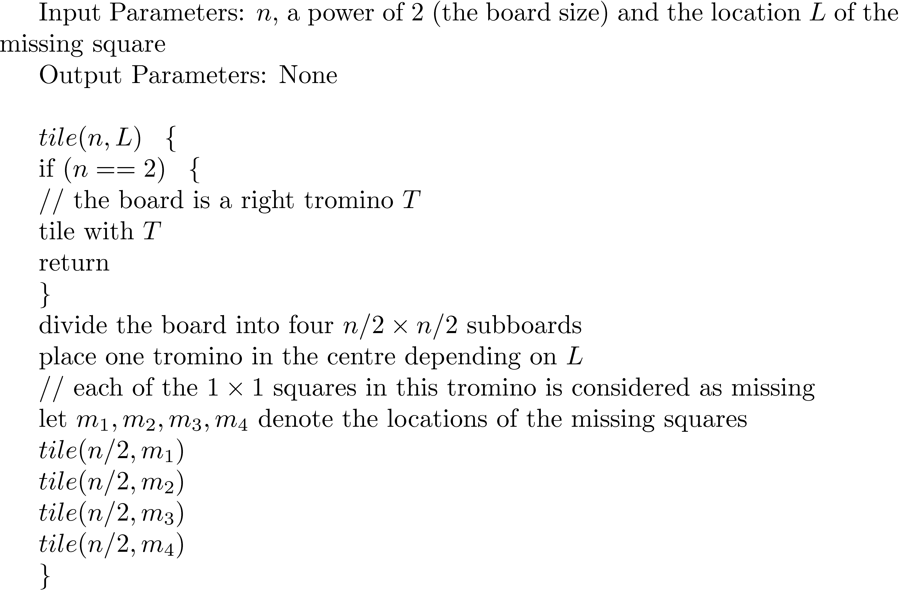
A Tiling Problem

Slide 19
Idea of the algorithm
Divide the problem of size n by n into four subproblems each of size n/2 by n/2.
Place one tromino at the centre to create missing cells in each subproblem.
Solve the subproblems using recursion.
2 by 2 problem is solved directly.

Slide 20
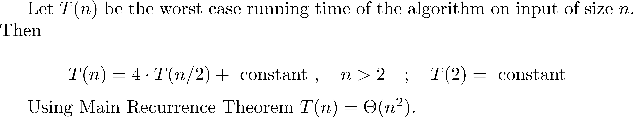
Time Analysis
Chu and Johnsonbaugh (1986) showed that if n ≠ 5, and n² - 1 is divisible by 3 then the n by n deficient board can be tiled using trominoes.
Some 5 by 5 boards can be tiled and some cannot.

Slide 21
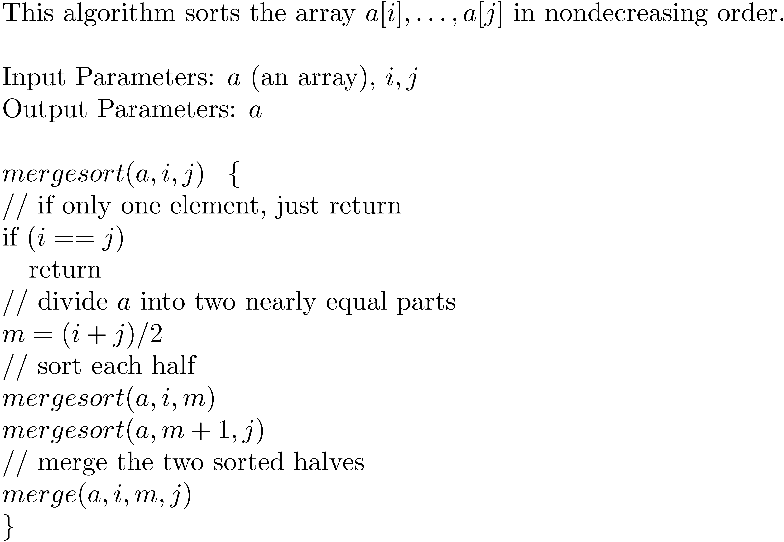
Mergesort

Slide 22
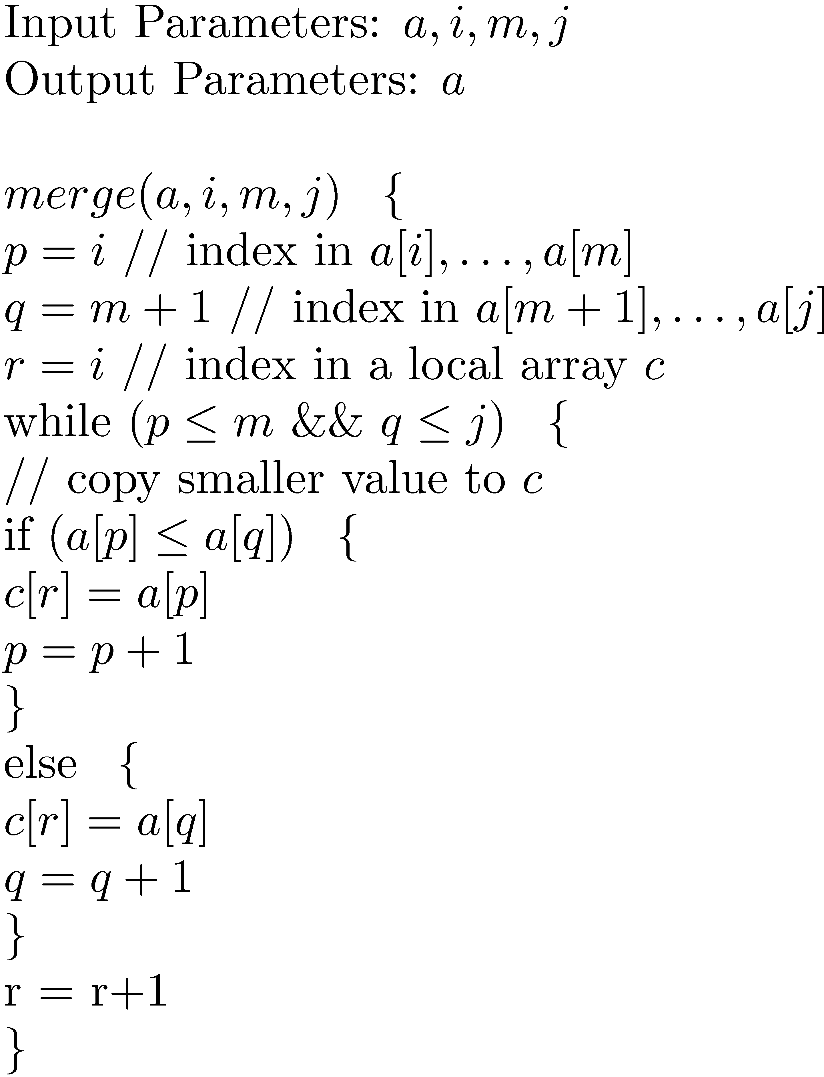
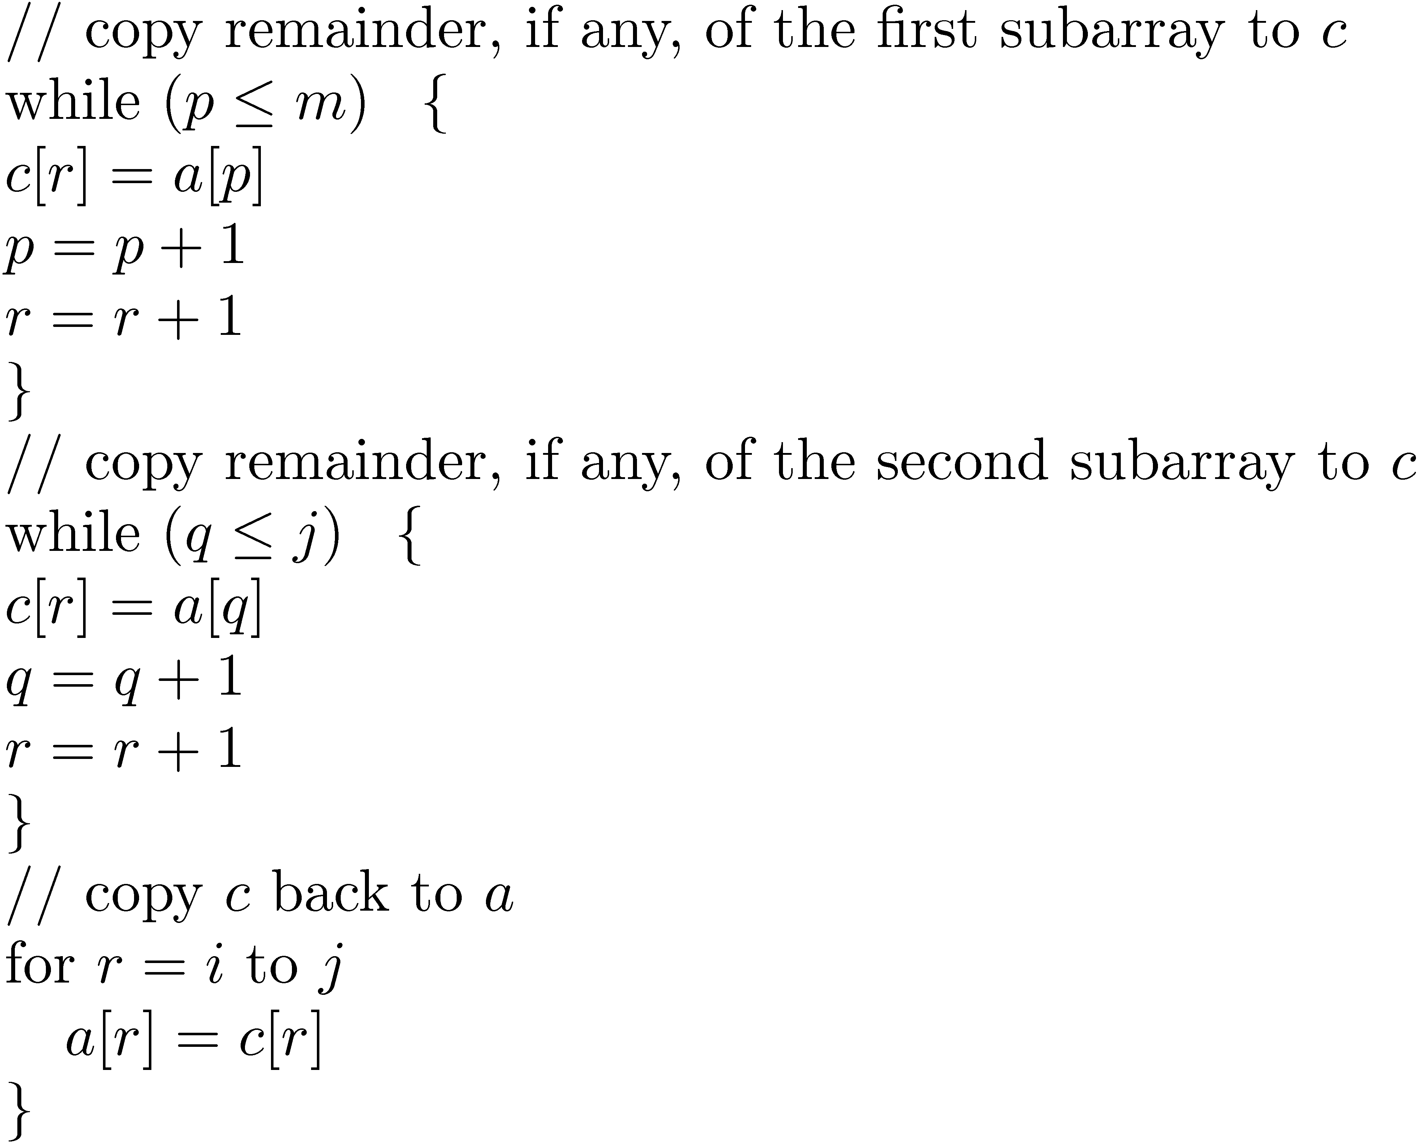
Subroutine Merge

Slide 23
Idea of the algorithm
Divide the array of size n into two arrays of size n/2.
Sort the two subarrays using recursion.
Merge the two sorted parts using subroutine merge.

Slide 24
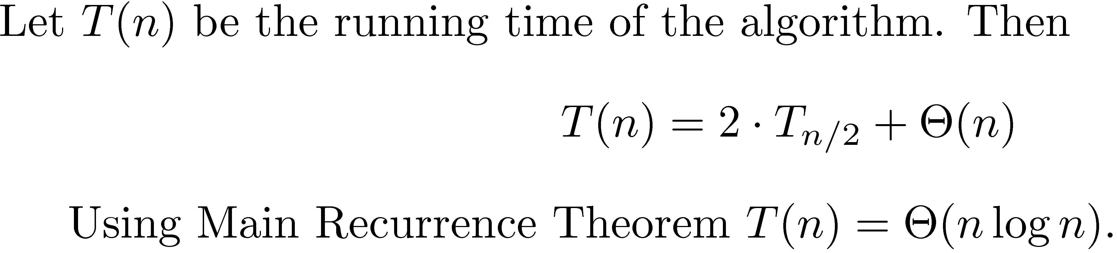
Mergesort – Time Analysis
Stable sort: A sorting algorithm is stable if the relative positions of items with duplicate values are unchanged by the algorithm.
Mergesort is stable.

Slide 25
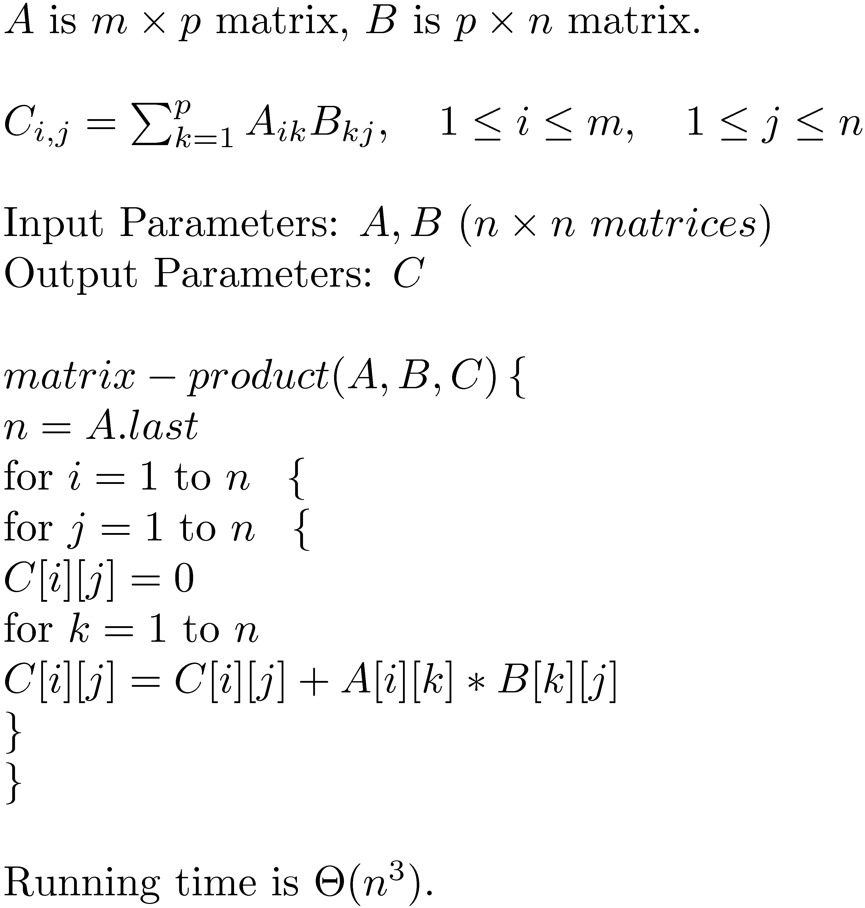
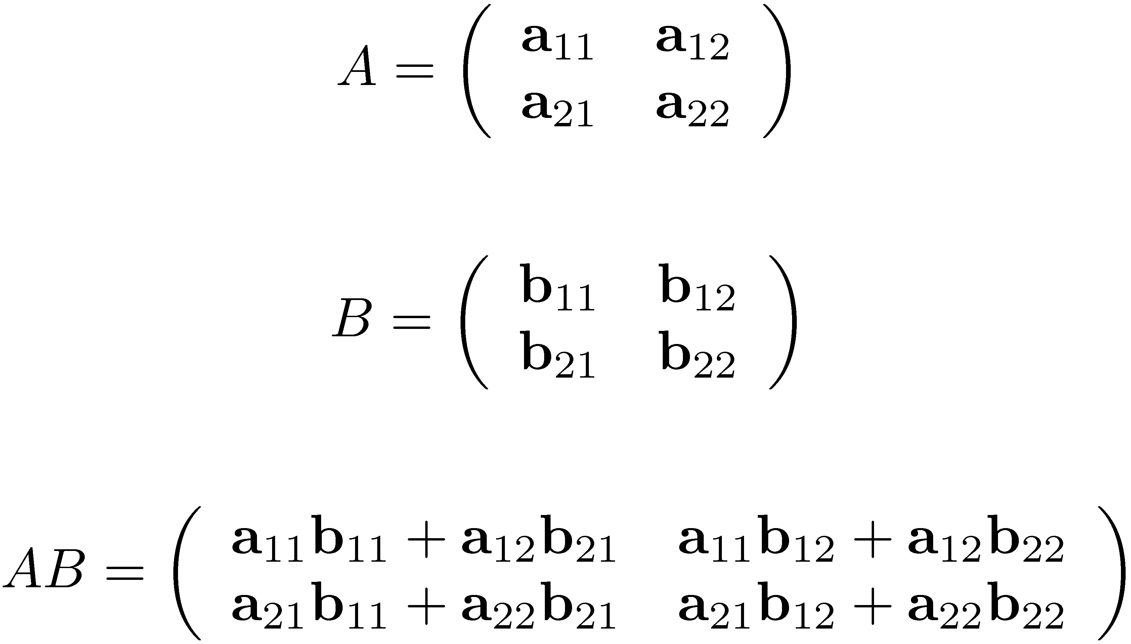
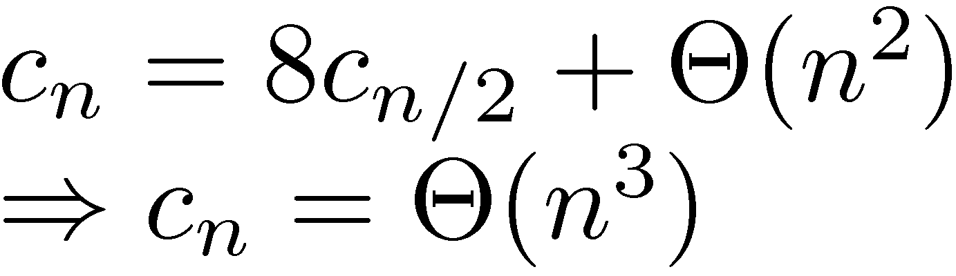
Strassen’s Matrix Product Algorithm

Slide 26
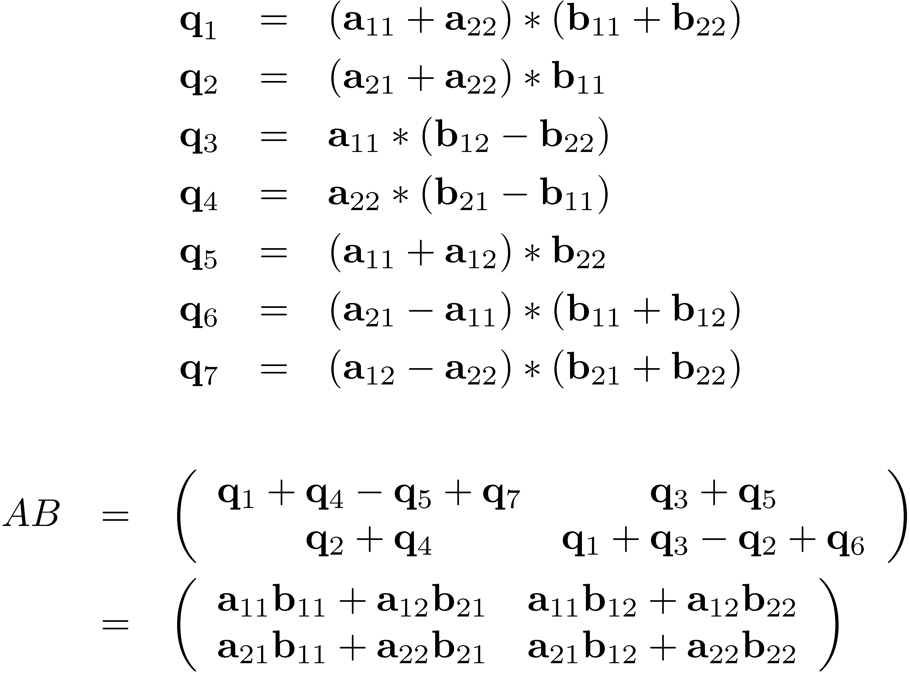
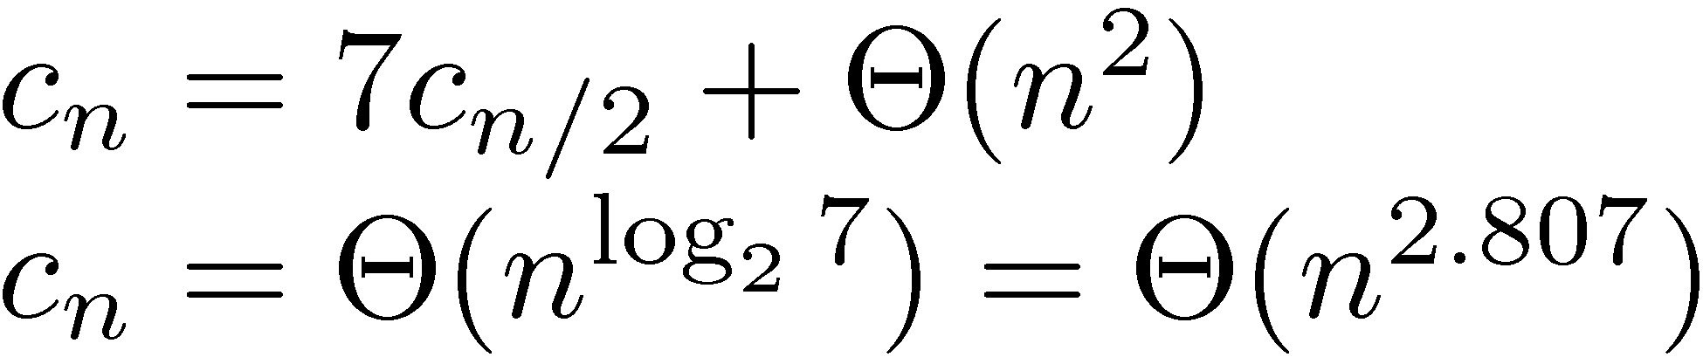
Strassen’s Matrix Product Algorithm

Slide 27
Idea of the algorithm
Divide the problem of multiplying two n by n matrices into the problem of multiplying 7, n/2 by n/2 matrices (you also do constant number of additions of n/2 by n/2 matrices).
Use recursion to solve the subproblems.

Slide 28
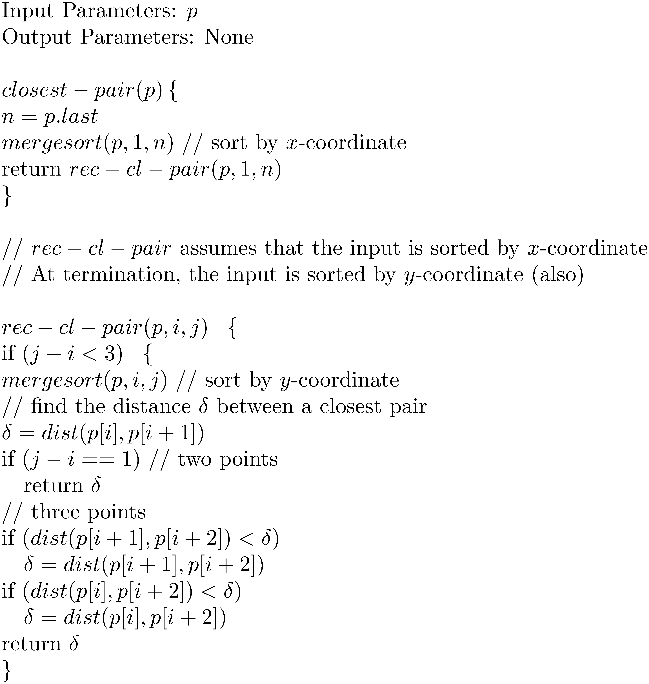
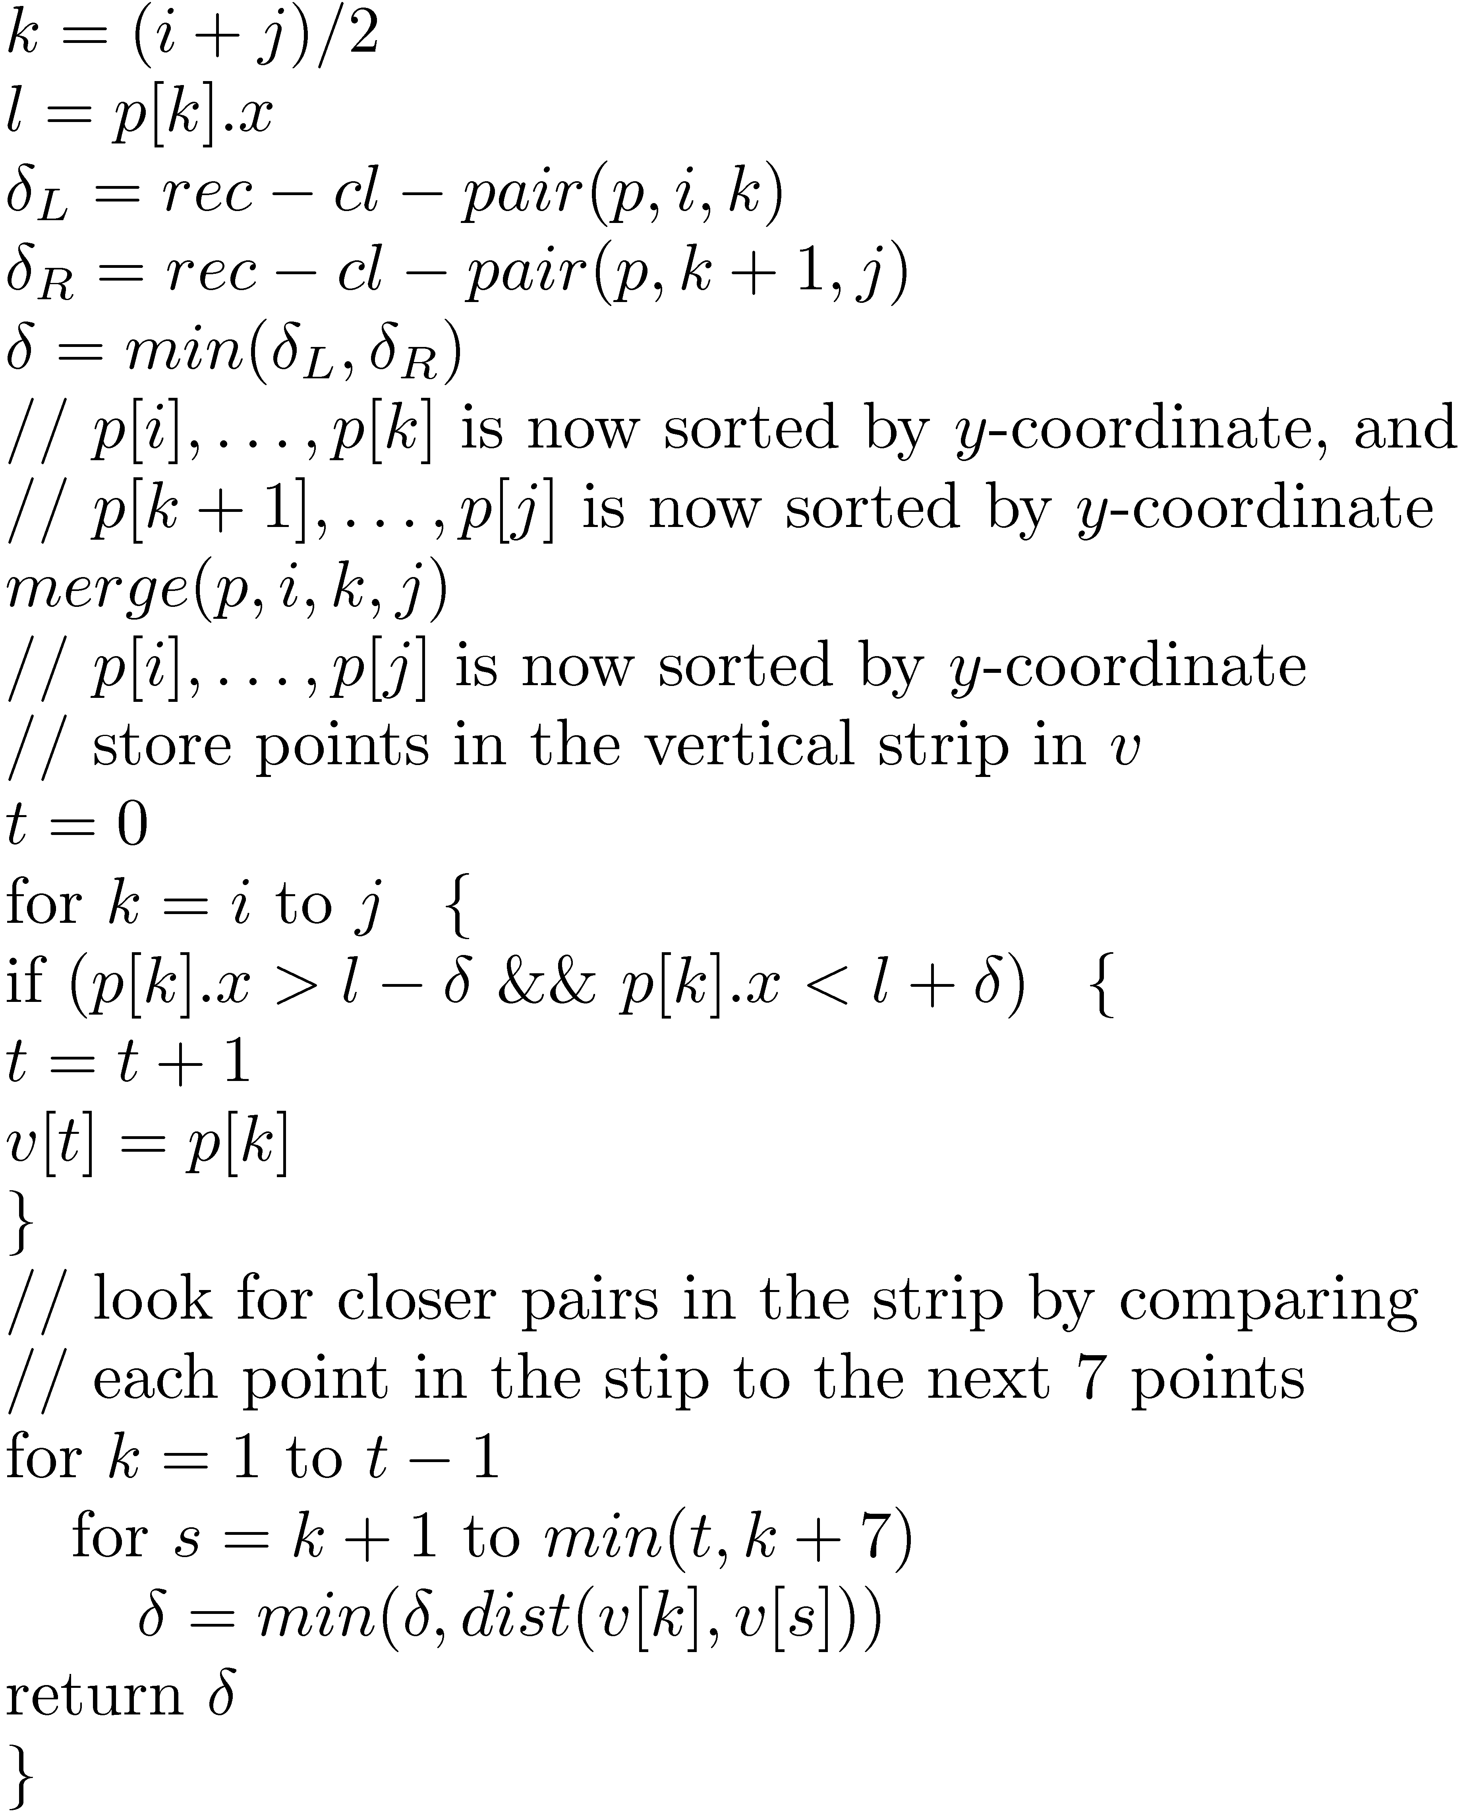
Finding a closest pair of points on the plane

Slide 29
Idea of the algorithm
Divide the set of n points on the plane into two halfs (using x-coordinate).
Find the shortest distance between pairs of points in the two halfs using recursion. Let delta be their minimum.
Consider a strip of size 2 times delta in the middle of the two halfs.
Sort the points in this strip using y-coordinate (this can be done only using merge since the subparts are already sorted according to y-coordinate).
Start from bottom and compare each point with the next seven points to identify the closest pair (this works because in each box that we considered there can be at most 8 points).

Slide 30
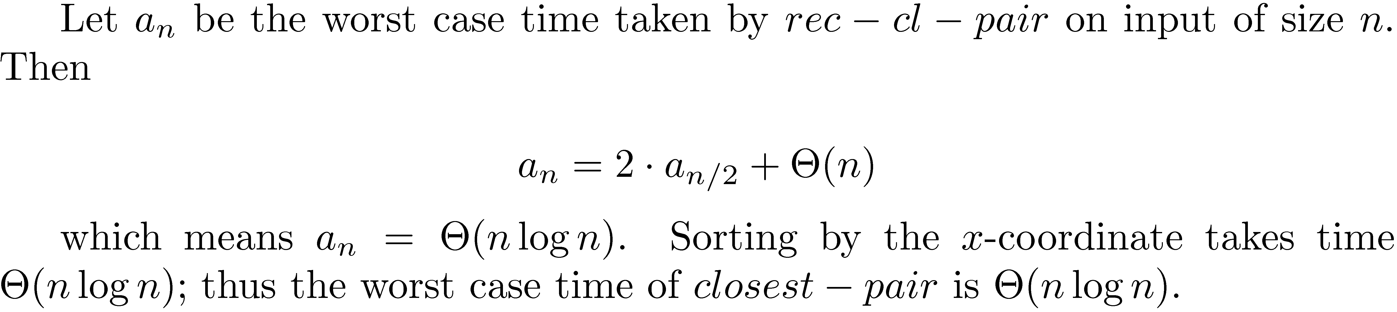
Time Analysis

Slide 31
What we did last time
Divide and conquer:
Tiling problem
Mergesort
Strassen’s matrix product
Finding closest pair of points on a plane

Slide 32
Sorting and Selection

Slide 33
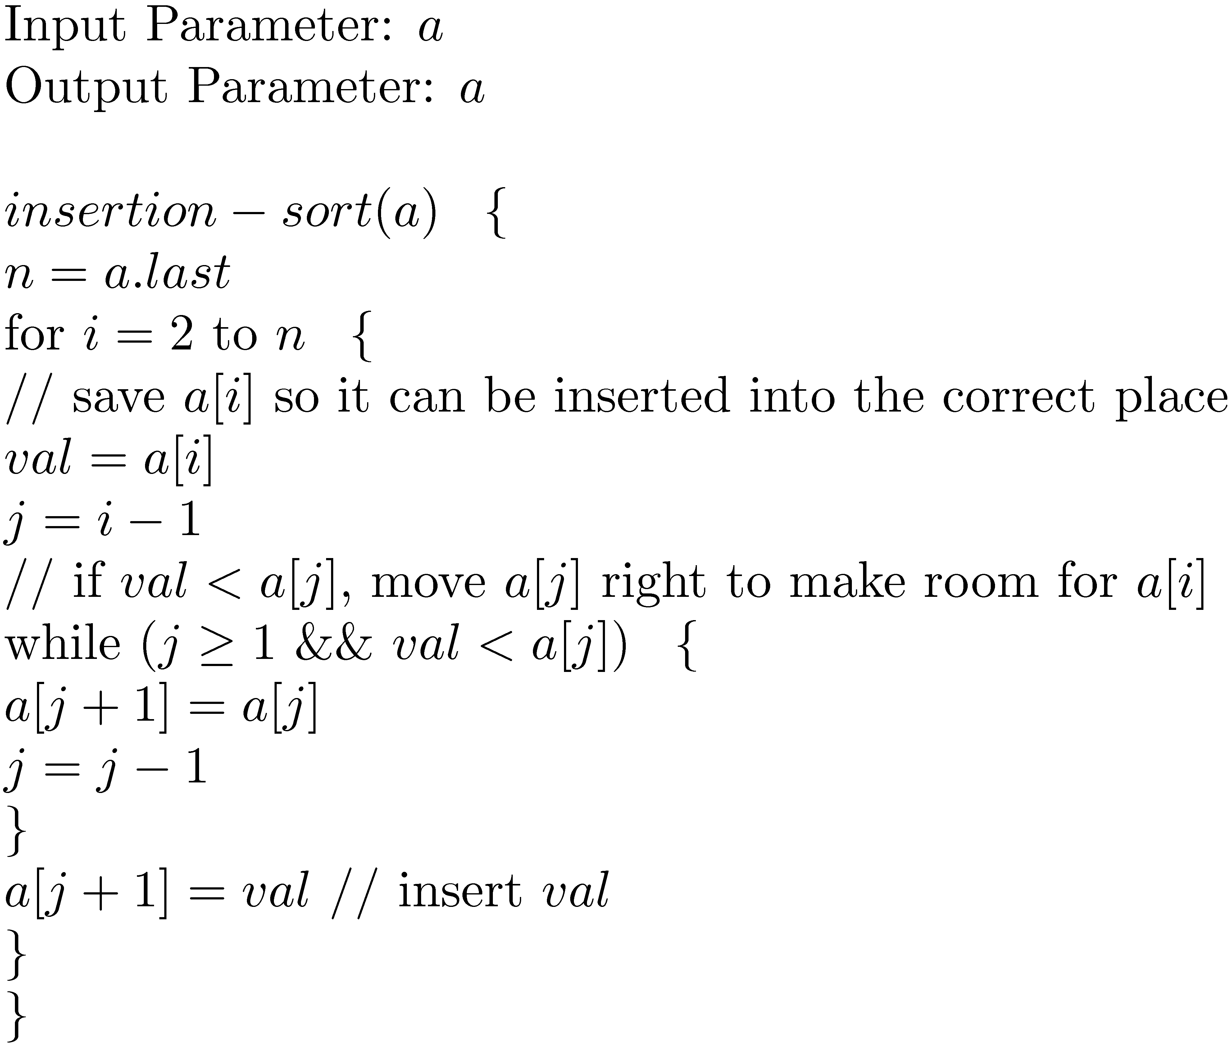
Insertion Sort

Slide 34
Idea of the algorithm
Assume that the elements of the array arrive one by one.
Keep inserting them at the right place in the current subarray which is already sorted.
Nice property: It is an online algorithm.

Slide 35
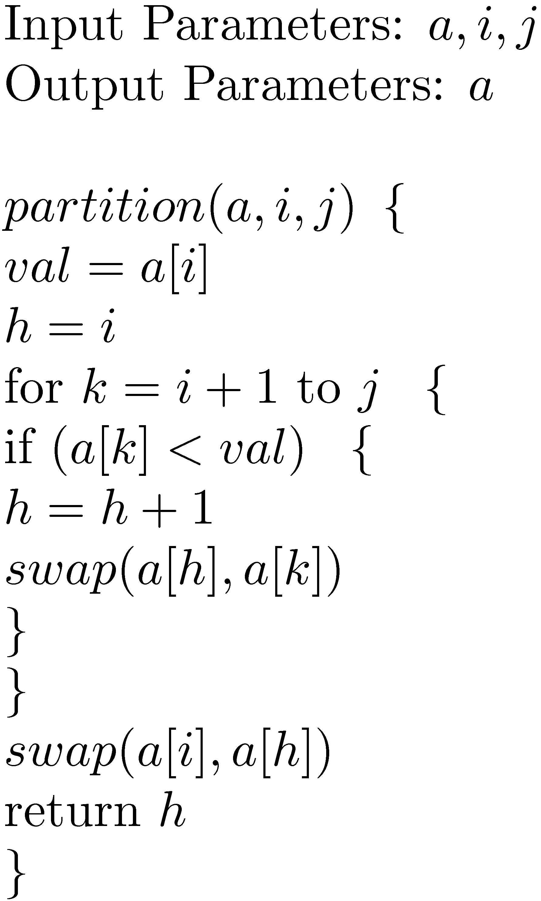
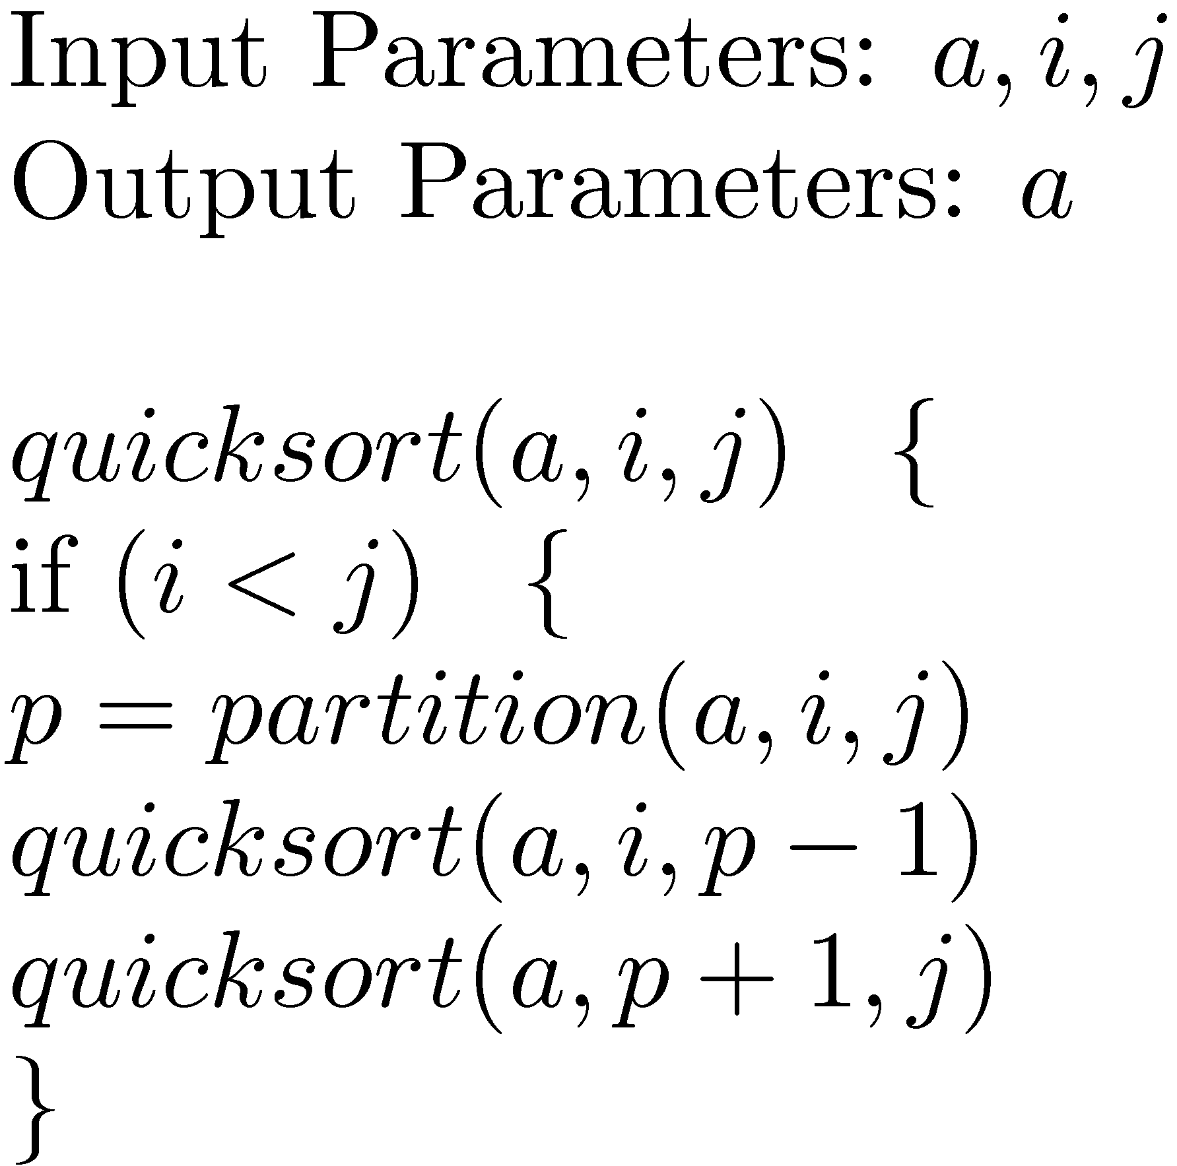
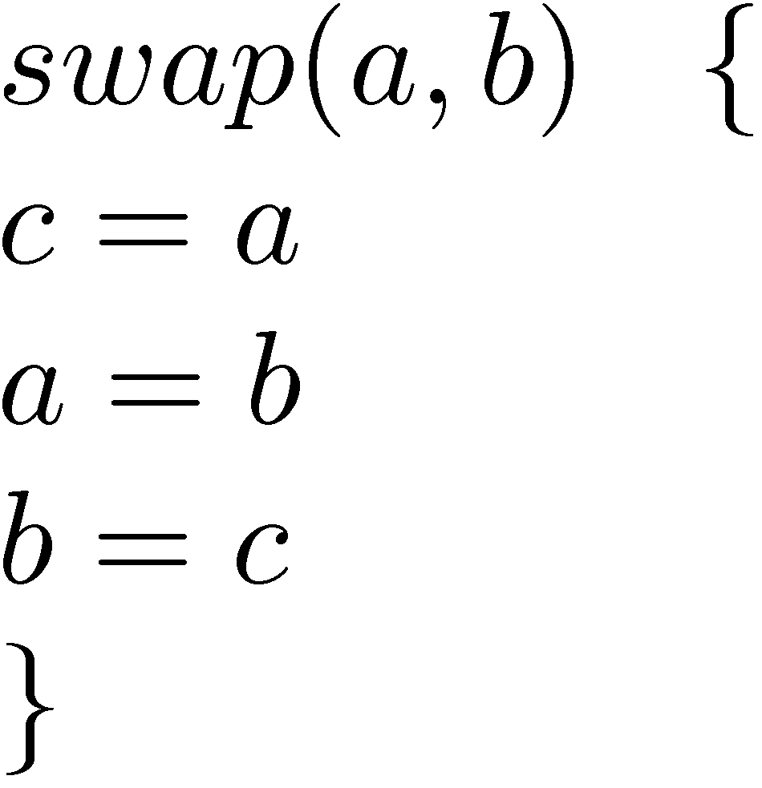
Quicksort
The algorithm ‘partition’ inserts val at the index h such that values less than val are on the left of index h and values at least val are on the right of h.
Quicksort Algorithm

Slide 36
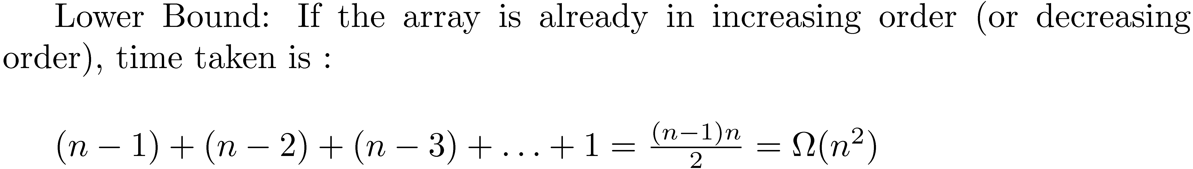
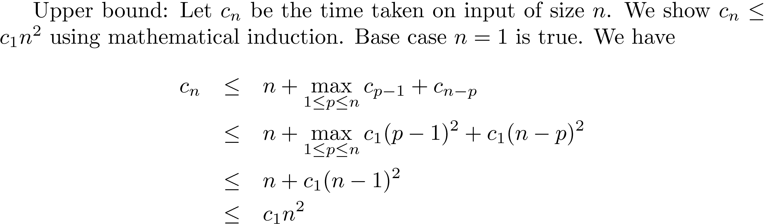
Quicksort : Time analysis

Slide 37
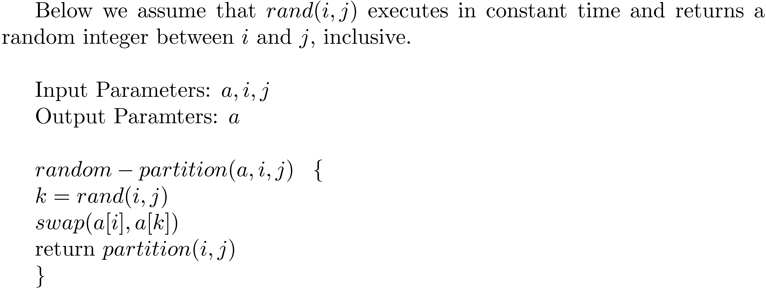
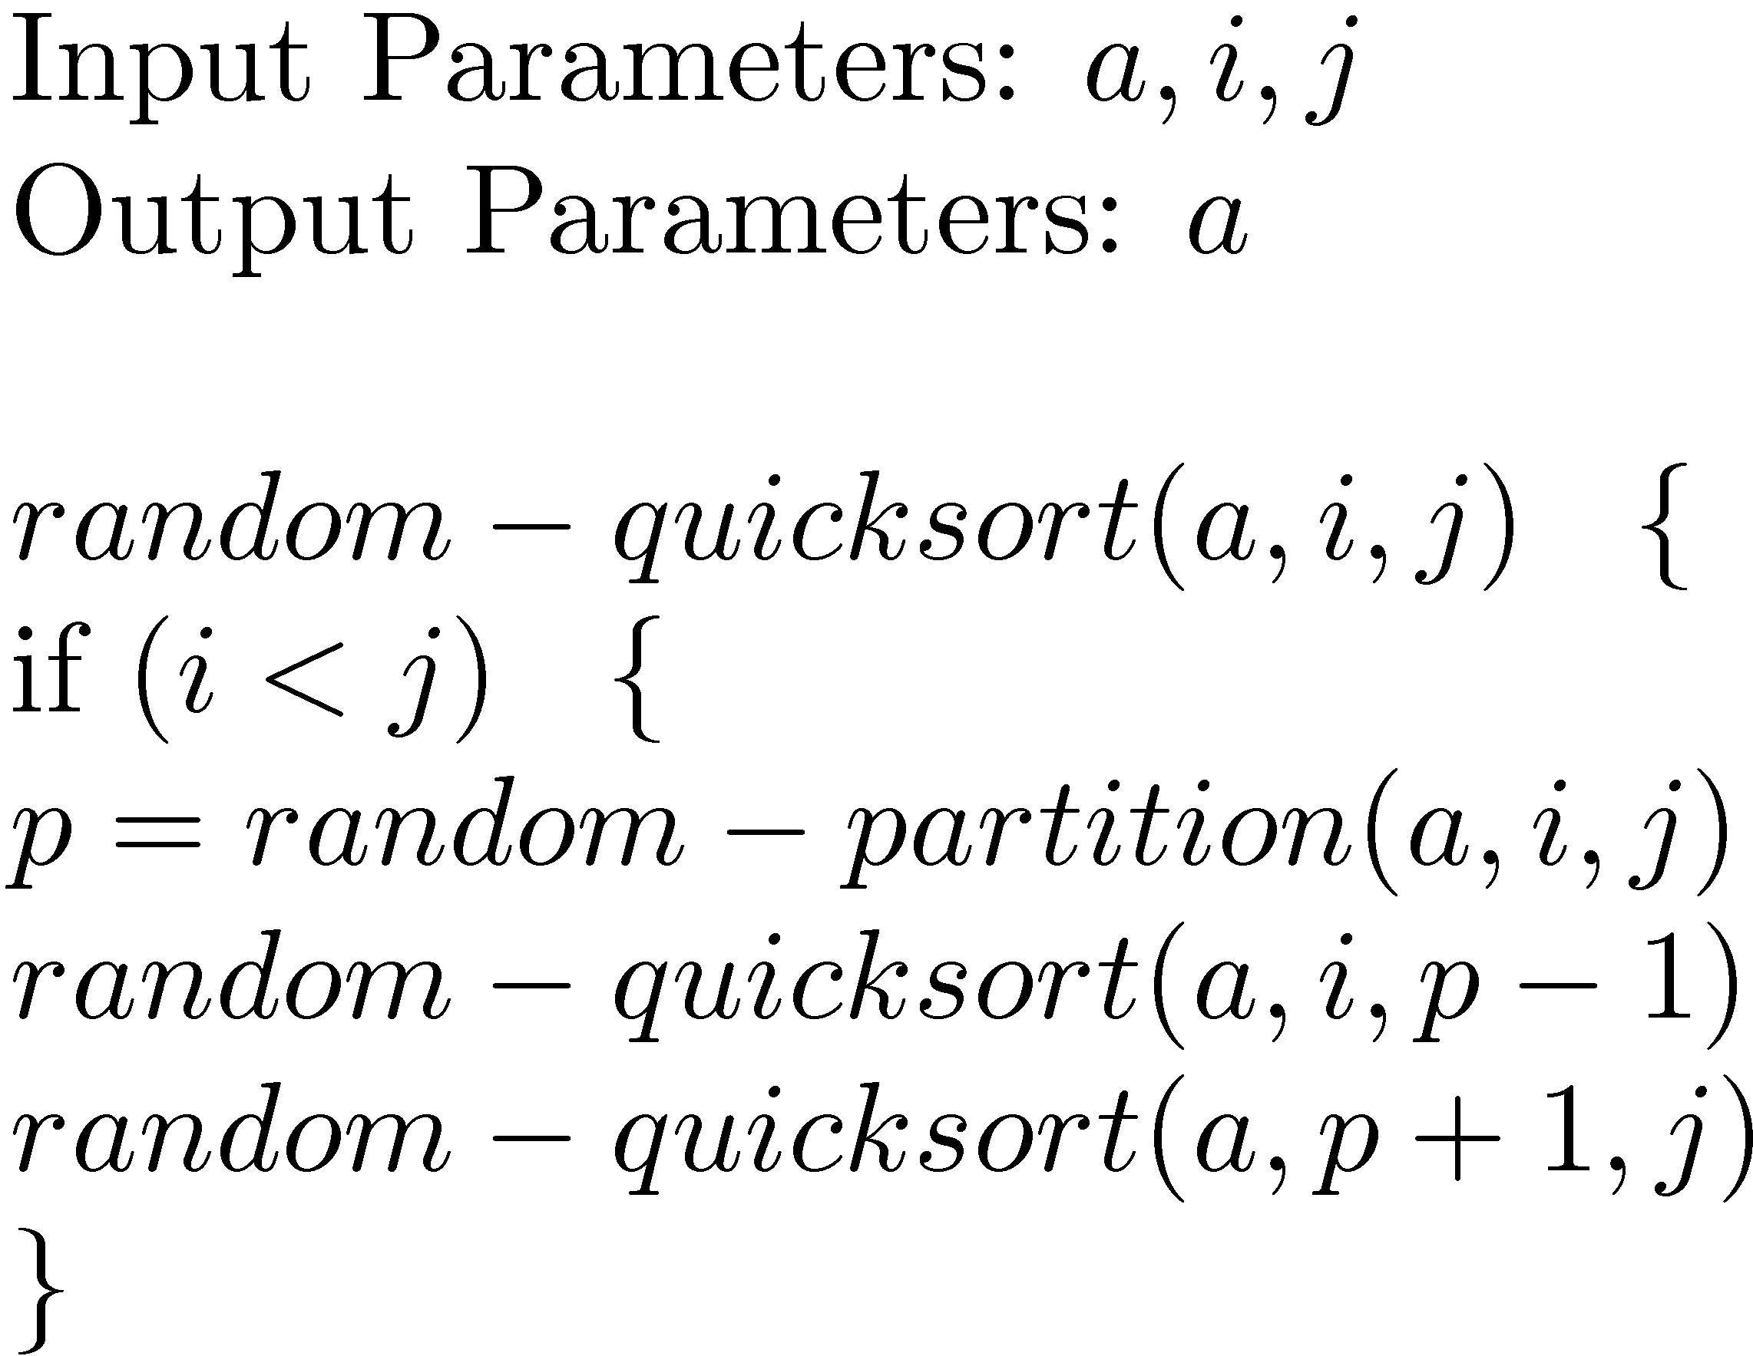
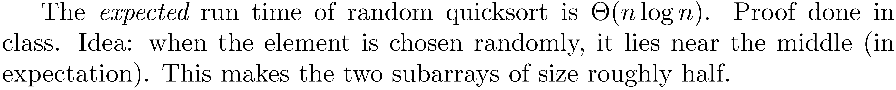
Randomized Quicksort
Randomized Quicksort

Slide 38
Idea for partition algorithm
Let the current stage of array be like : F SSSS LLLL C RRRRR
F is first element, S < F, L ≥ F, C is the current element, R is rest of the elements.
If current element C ≥ F, then don’t do anything, just let next element on right to be C.
If C < F, then swap C with first L, and let next element on right to be C.
At the end swap F with the last S element.

Slide 39
Idea of the algorithms
Take an element of the array (of value val) and place it at the right index h. Elements to the left of h are less than val and to the right are greater than or equal to val (partition algorithm).
Recursively sort a[i] … a[h-1] and a[h+1] … a[j]
In normal quicksort, the element is taken to be the first element of the array.
In randomized quicksort, the element is randomly chosen among all elements.
Quicksort is quite good in practice that is why ‘quicksort’.
No extra array is needed.
Quicksort is not stable.

Slide 40
A lower bound for comparison based algorithms
The worst case time of a comparison based sorting algorithm is Ω(n log n).
Proof done in class. Idea: Any comparison based algorithm will have a decision tree, with n! leaves (for n bit inputs). Height of this tree is Ω(n log n).
A decision tree for the comparison based algorithm is a binary tree with the nodes representing comparisons (a < b?), the left subtree represents the continuation of the algorithm on the result of comparison being yes and the right subtree represents the continuation of the algorithm on the result of comparison being no.

Slide 41
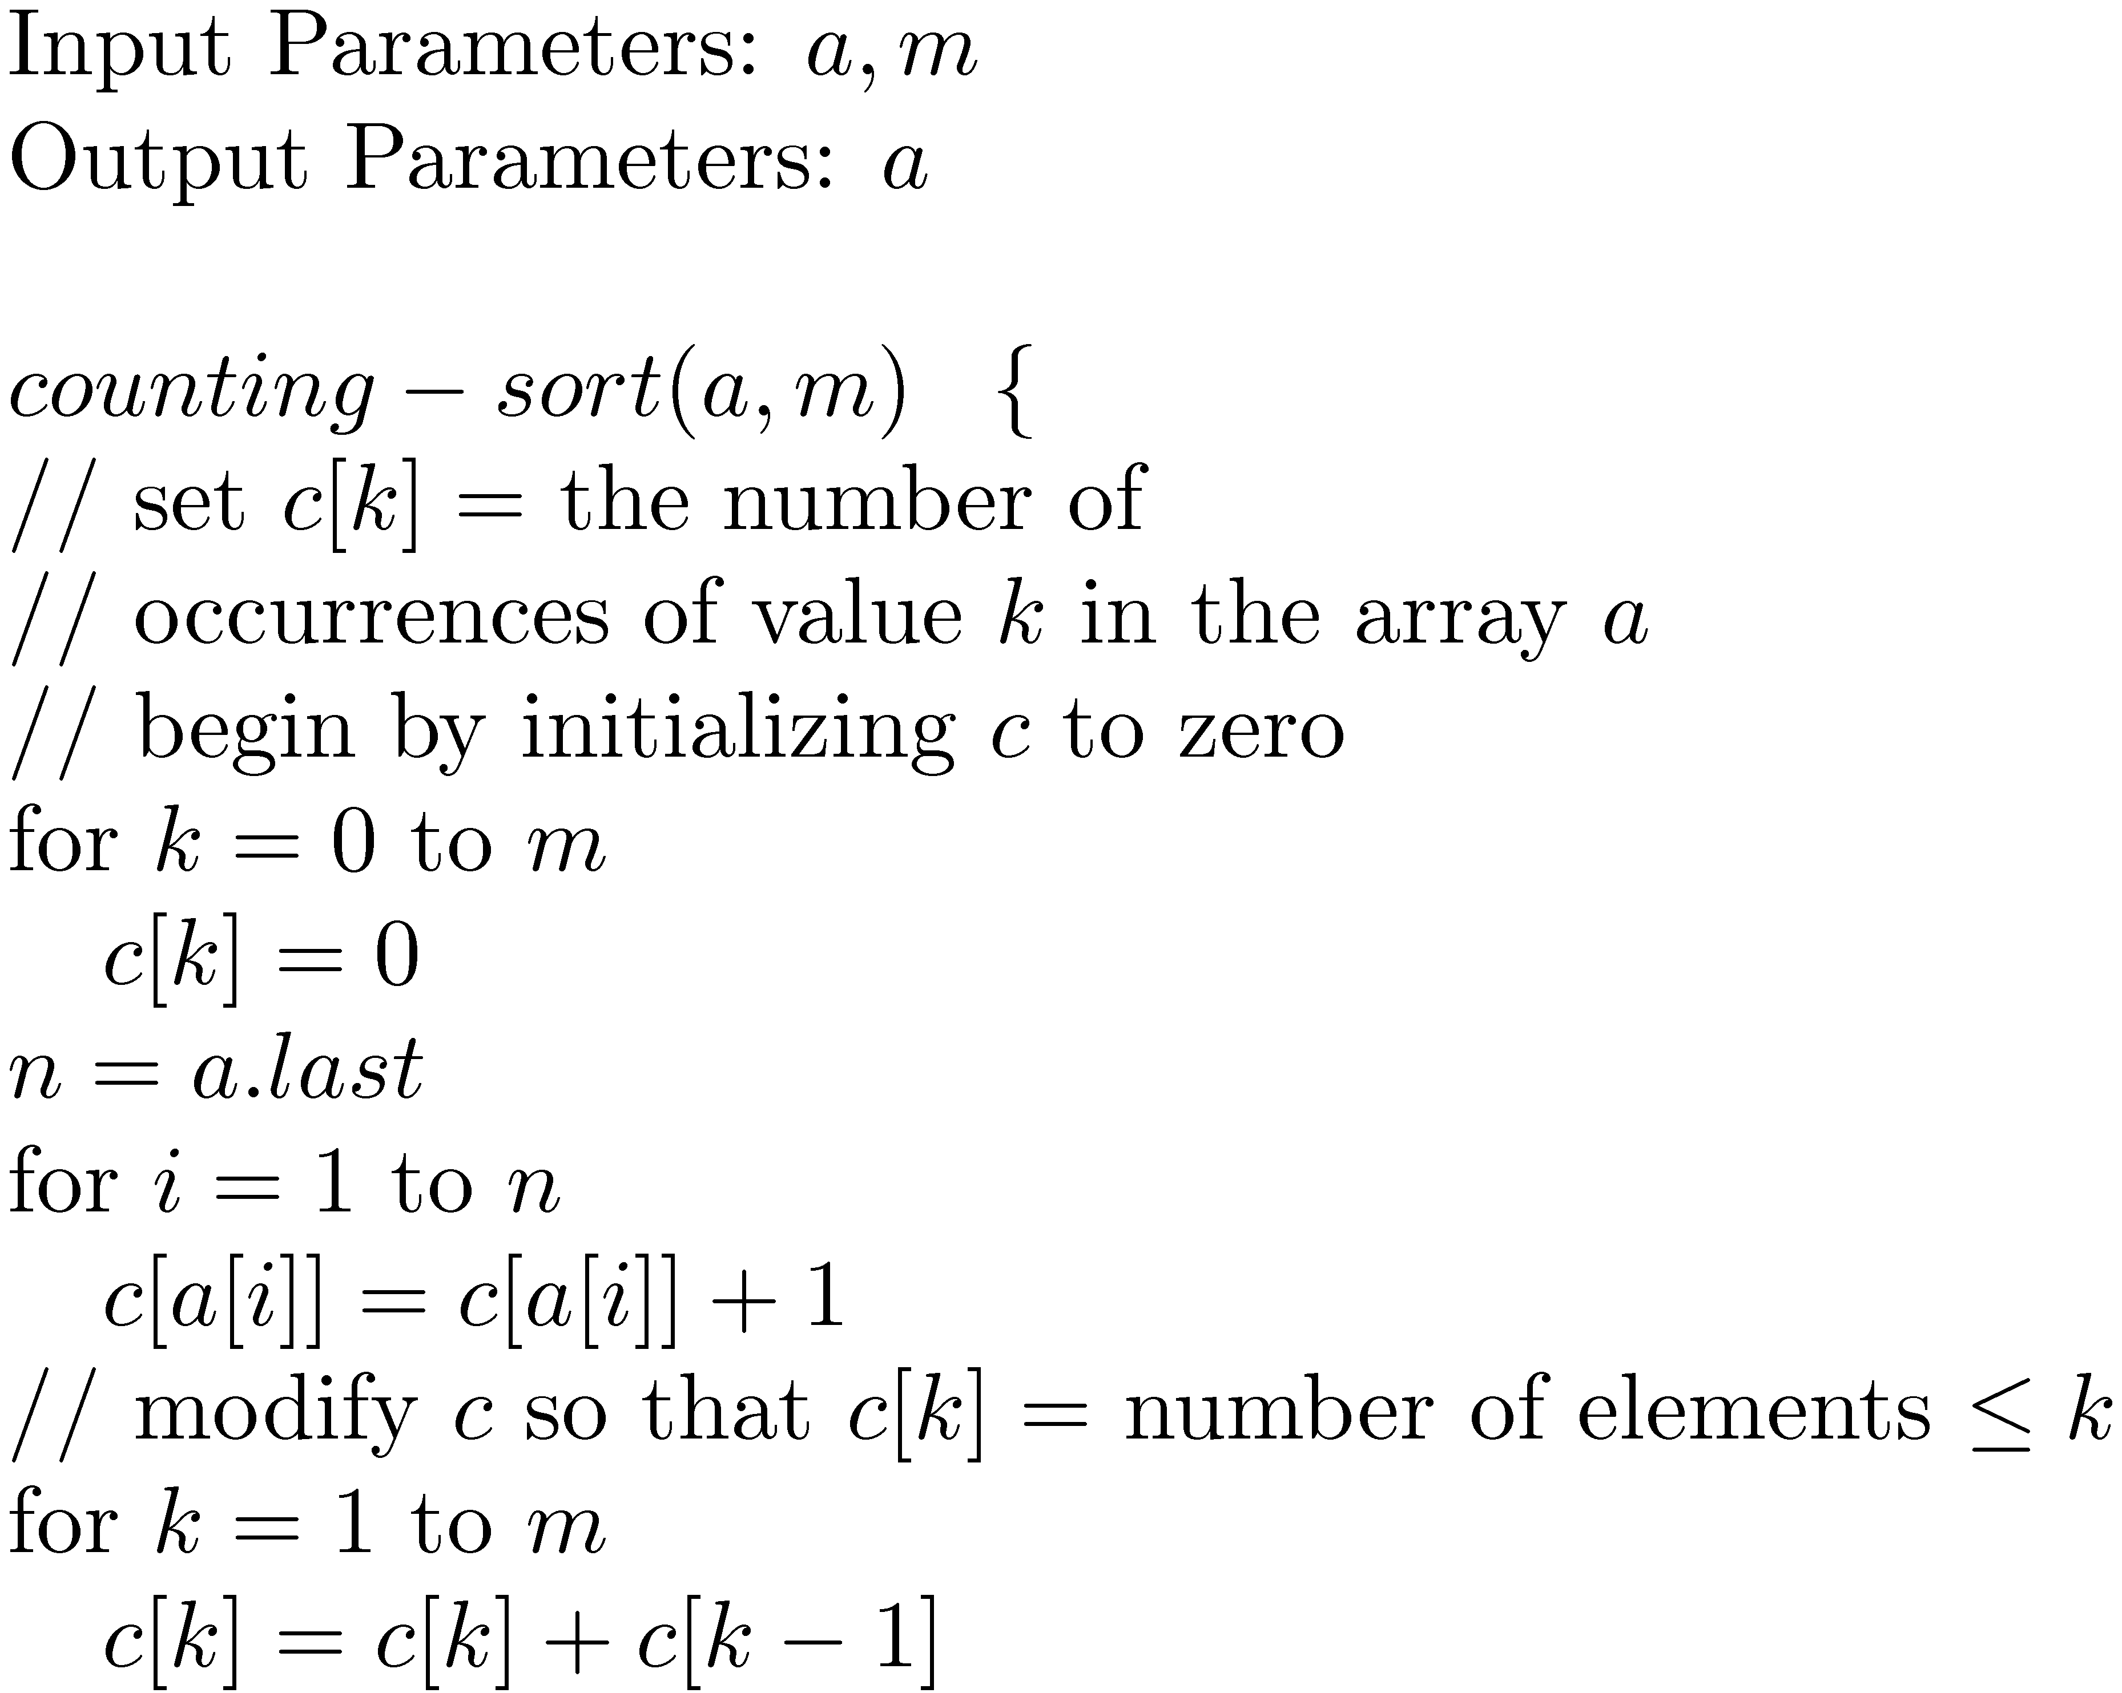
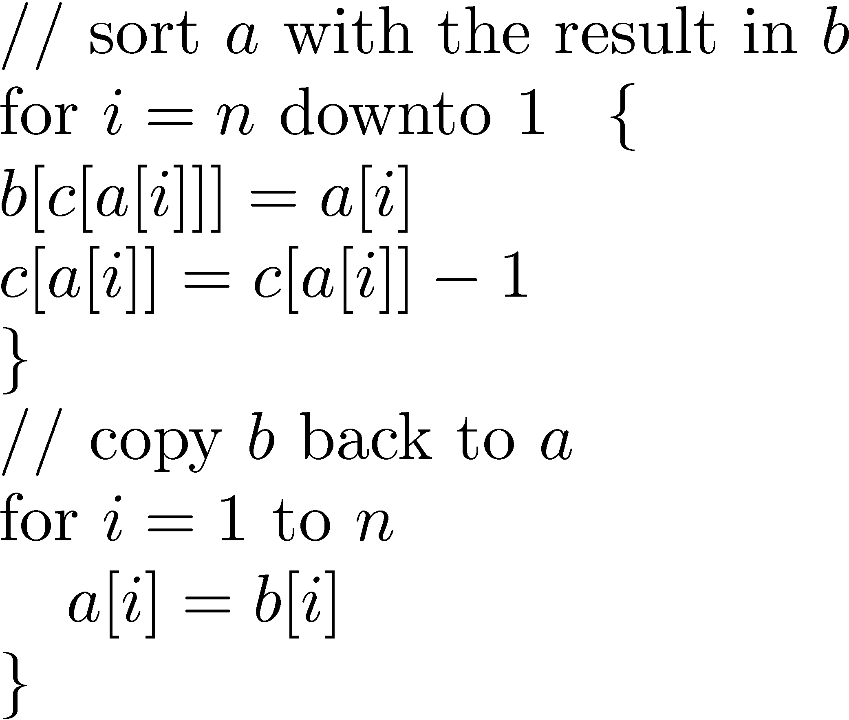
Counting Sort
Not a comparison based algorithm, uses some information about the inputs i.e. the elements are numbers from 0 to m.
Running time is linear, lower bound of Ω(n log n) does not apply.

Slide 42
Time analysis
Since each loop runs in time θ(m) or θ(n), the running time is θ(m + n).
Idea of algorithm
First make sure that c[k] = number of occurrences of value k in input array a.
Then make sure that c[k] = number of occurrences of value less than or equal to k in input array a.
Produce sorted array b using c.
Copy b back to a.
Counting sort is stable (done in tutorial).

Slide 43
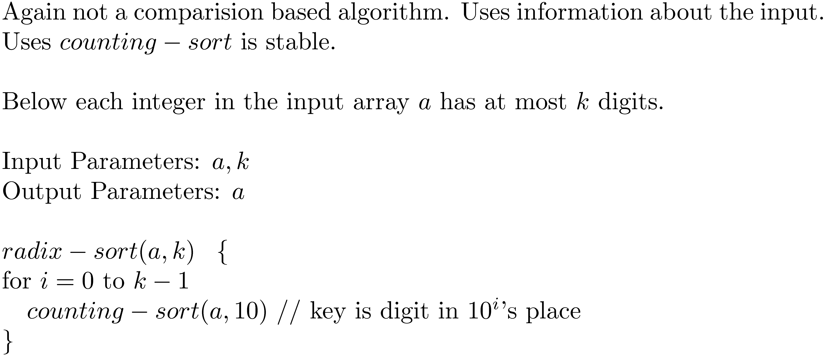
Radix Sort
Idea of algorithm: Starting from the least significant digit, sort using counting-sort.
Correctness of the algorithm shown in class. Running time is done in tutorial.
Radix sort was originally used to sort punch cards.

Slide 44
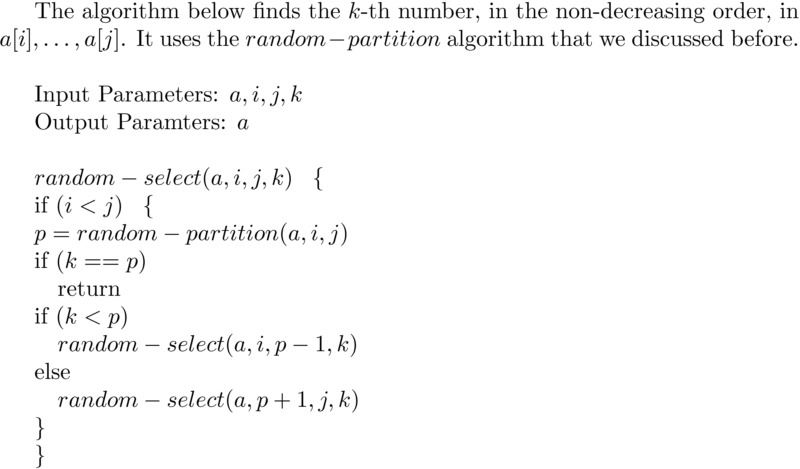
(Random) Selection
Finding median is a special case of this.

Slide 45
Idea of algorithm
Using random-partition, get location p (note that everything to the left of p will be smaller than the value at p and everything to the right will be at least the value at p.)
If k = p then stop.
If k < p, act recursively on the left of p.
Else act recursively on the right of p.
Running Time : The expected running time is θ(n). Proof done in class. Idea similar to the analysis of random-partition. When element is selected randomly, p is near middle (in expectation).
The worst case time of random-select is θ(n²) (done in tutorial).
Any deterministic algorithm solving selection must take time at least n.
Deterministic algorithm due to Blum, Floyd, Pratt, Rivest and Tarjan (1973) runs in time θ(n).

Slide 46
What we did last time
Selection sort
Quicksort
Lower bound for comparison based algorithms
Couting sort, Radix sort (not comparison based)
Random Selection

Slide 47
Greedy Algorithms
Greed is Good !

Slide 48
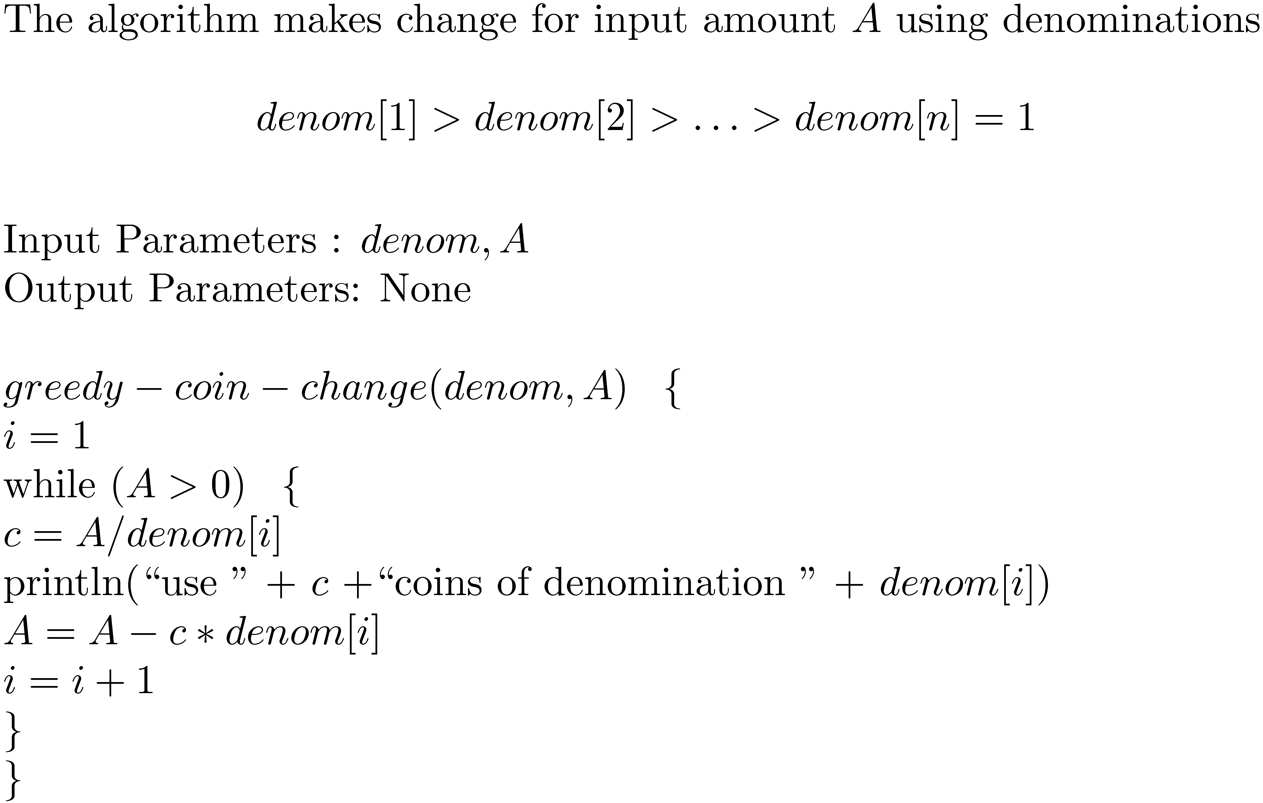
Coin Changing
The algorithm is not optimal for denominations {1,6,10}.

Slide 49
Optimality for {1,5,10}
The algorithm is optimal for denominations {1,5,10} for every input amount A. Idea: use mathematical induction.
Let greedy(A) represent the number of coins used by the greedy algorithm for input amount A.
Let optimal(A) represent the optimal number of coins for amount A.
Can verify by direct calculation for A = 1, 2, … , 9, that greedy(A) = optimal(A).
Let A ≥ 10. Then by induction hypothesis: greedy(A-10) = optimal(A-10).
Note that greedy(A) = 1+ greedy(A-10).
Also note that optimal(A) = 1 + optimal(A-10) (since optimal solution must use at least one 10 dollar coin for A ≥ 10).
Hence greedy(A) = optimal(A).
What goes wrong with {1,6,10} in this argument ?

Slide 50
Kruskal’s Algorithm
Kruskal’s algorithm finds a minimal spanning tree in a connected, weighted graph G with vertex set {1, …, n}.
A spanning tree is a tree T such that every pair of vertices are connected via edges in T. A minimal spanning tree is a spanning tree such that the sum of the weights of all its edges is the least among all spanning trees.
Note: A forest with (n-1) edges is a spanning tree.
Idea (Greedy approach):
Start with S having no edges.
Add an edge of minimum weight not contained in S, to S, such that S does not contain a cycle.
Keep doing this till S contains n-1 edges.
At the end since S is a forest with n-1 edges, it must be a spanning tree.

Slide 51
Kruskal’s Algorithm
The input to the algorithm is edgelist, an array of edge, and n. The members of edge are:
v and w, the vertices on which the edge is incident.
weight, the weight of the edge.
The algorithm uses subroutines that manipulate sets of vertices:
makeset(v): makes a set containing the vertex v alone.
findset(v) : returns the name (e.g. the least element in it) of the set containing vertex v.
union(v,w): does the union of the sets containing v and w.
We can assume that these subroutines run in time O(log n).

Slide 52
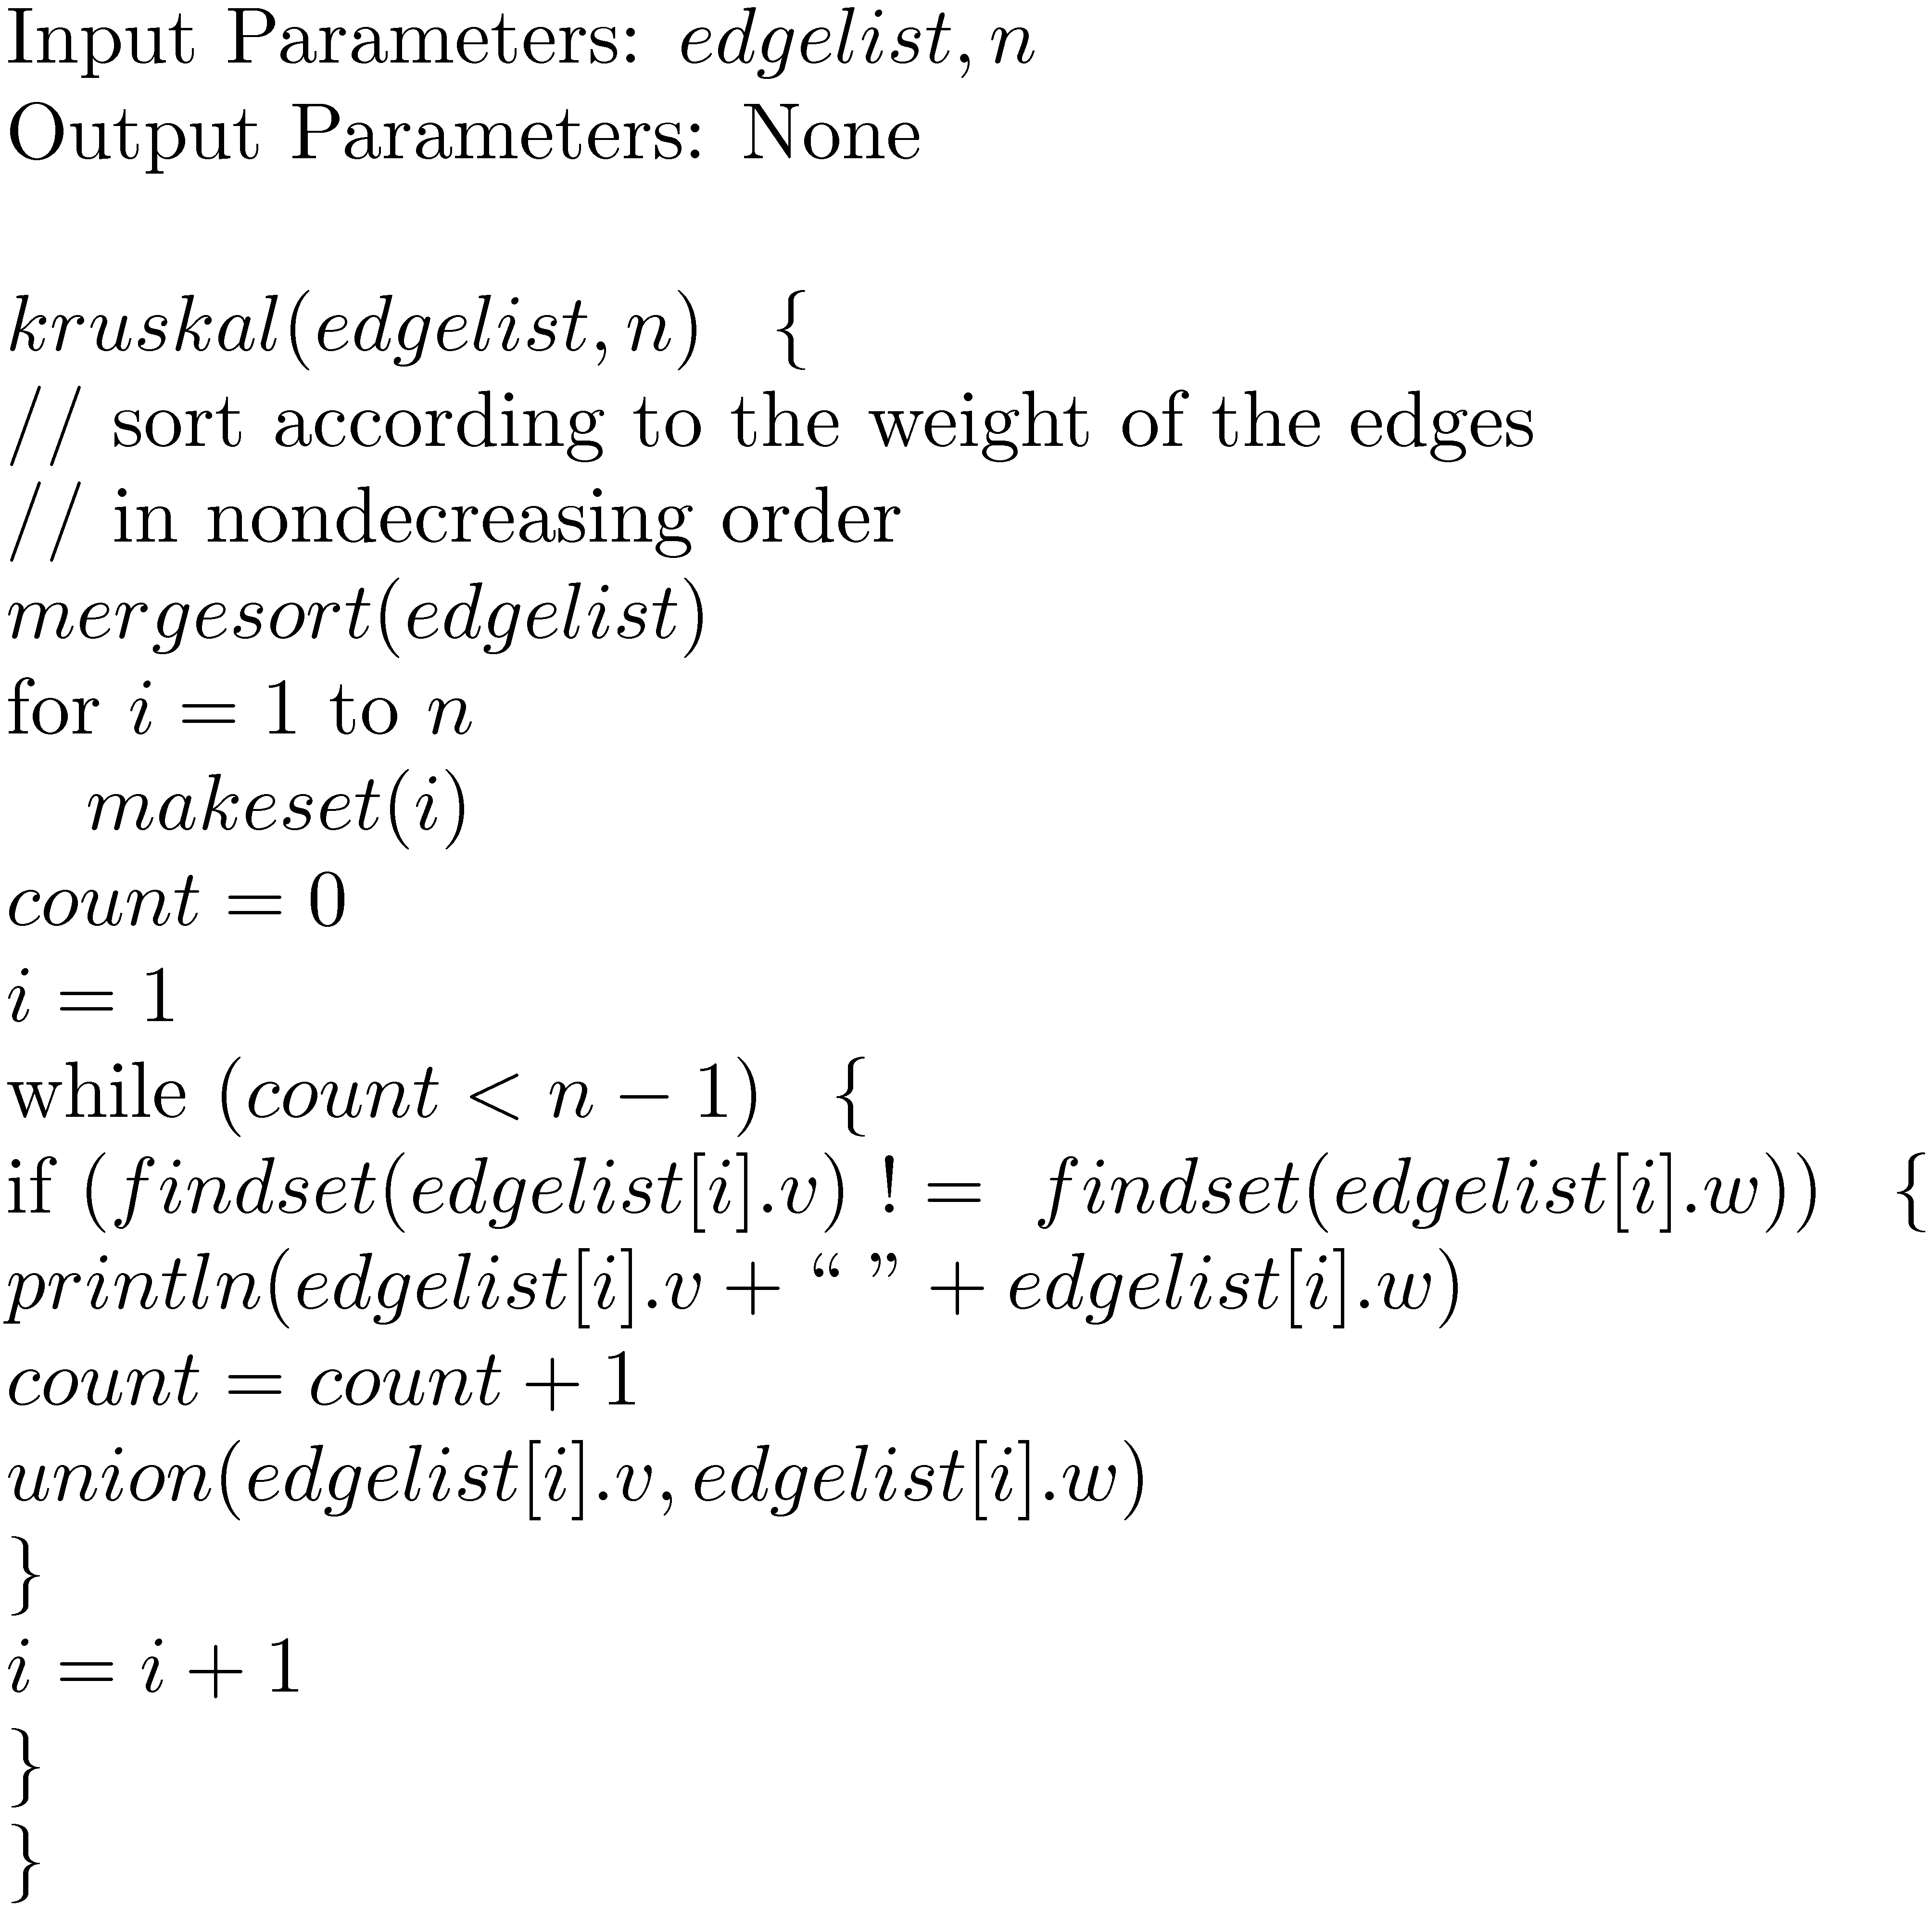
Kruskal’s Algorithm
Time Analysis:
Since the graph is connected
m ≥ n-1.
There are O(m) makeset, findset and union operations, time taken is O(m log m).
Sorting takes time θ(m log m ).
Hence total time is θ(m log m ).

Slide 53
Correctness of Kruskal’s Algorithm Proof Idea
Let S be the set of edges chosen so far by the algorithm.
We show by induction that S is a part of a minimal spanning tree.
Base case is true since at the beginning, S is empty.
Let e be the new edge chosen by the algorithm. Let the statement be true for S and we show it is true for S U {e}.
Let T be a minimal spanning tree containing S. If T contains S U {e} then we are done. Otherwise T U {e} must form a cycle C.
Let e1 be an edge in T not is S which is part of C. Then weight(e1) ≥ weight(e) (since: we could have added either e1 or e but we added e).
Consider T1 = T U {e} – {e1}. Then T1 is also a spanning tree and T1 contains S U {e}. Also weight (T) ≥ weight(T1). But T was a minimal spanning tree and hence T1 is also a minimal spanning tree. Hence S U {e} is part of a minimal spanning tree T1.
At the end of the algorithm S contains n-1 edges and is a part of minimal spanning tree and hence it is a minimal spanning tree.

Slide 54
Prim’s Algorithm
Prim’s algorithm finds a minimal spanning tree in a connected, weighted graph G with vertex set {1, …, n}.
Only difference with Kruskal’s algorithm: Intermediate graph is a tree instead of a forest.
Idea (Greedy approach):
Start with S having no edges.
Add an edge e of minimum weight not contained in S, to S, such that S does not contain a cycle.
Ensure that one of the endpoints of e touches S and the other does not (this is the only difference with Kruskal’s algorithm).
Keep doing this till S contains n-1 edges.
At the end since S is a tree with n-1 edges, it must be a spanning tree (proof of correctness done in class, similar to Kruskal Algorithm’s proof of correctness).
Running time: Can be made θ(m log n ) by using binary heaps and can be made
θ(m + log n ) by using Fibonacci heaps.

Slide 55
Quiz-1 (5 marks, 15 minutes, open book)
Write an algorithm (pseudocode) which has:
Input: An array a (an n element array, all elements distinct)
Output: A 2 dimensional array perm (which has n! rows and n columns; perm[i,j] represents the element in the ith row and the jth column). Each row of perm is a distinct permutation of the elements of a.

Slide 56
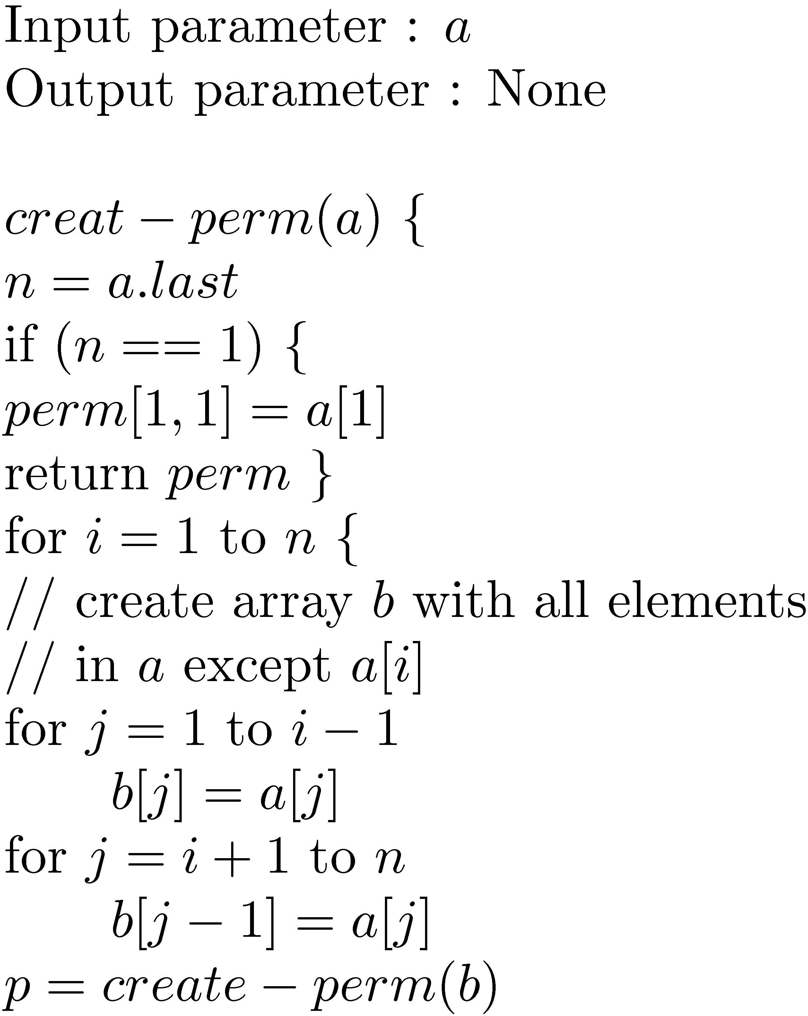
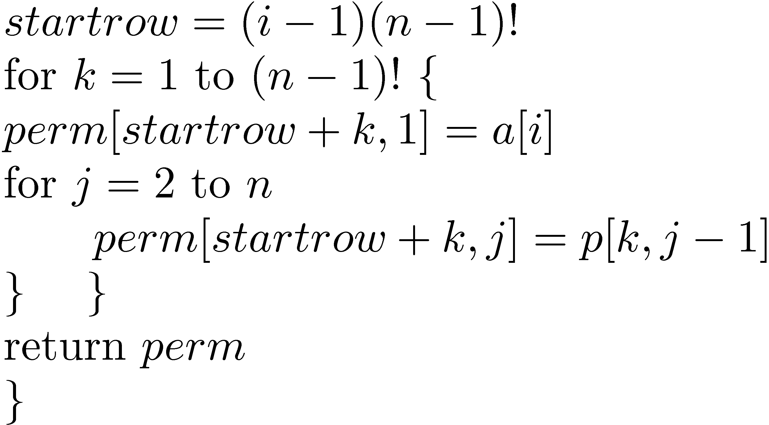
Quiz-1: One Solution

Slide 57
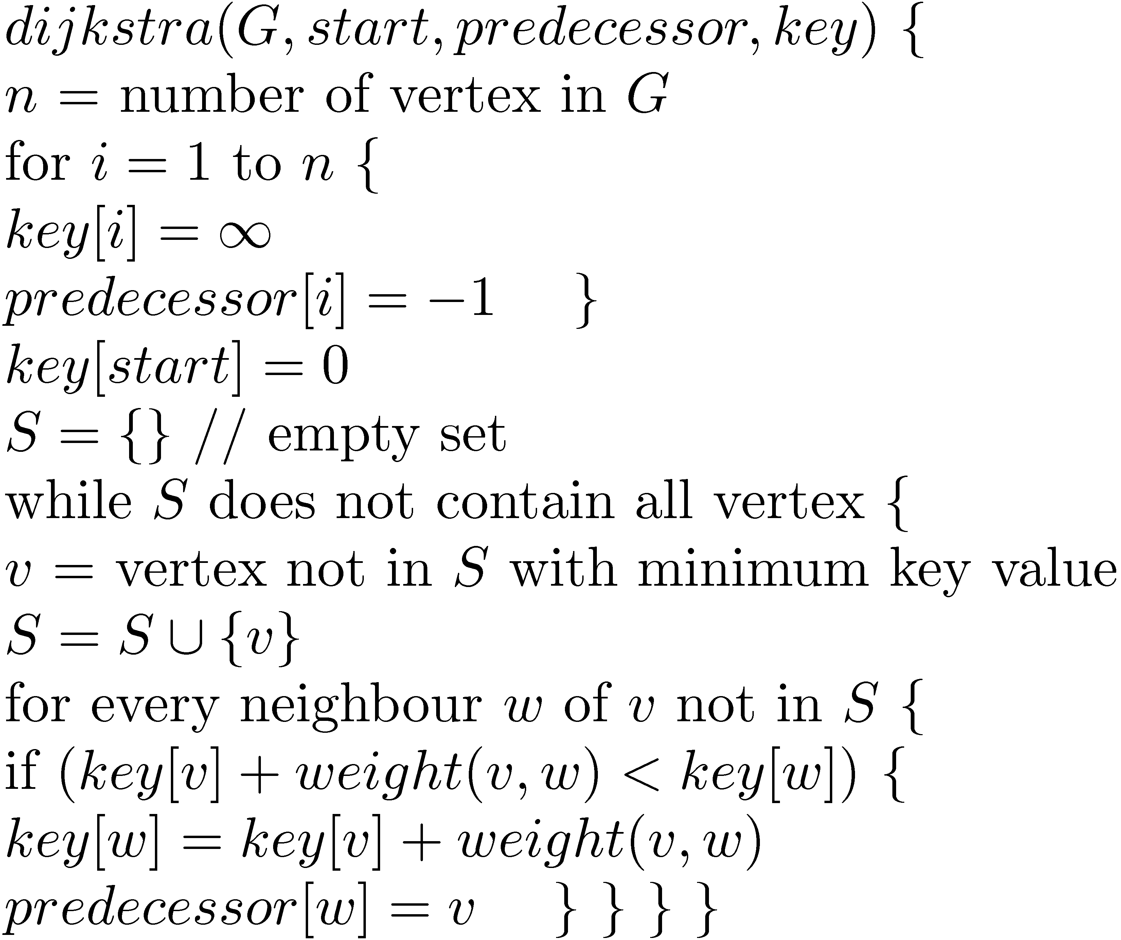
Dijkstra’s Algorithm
This algorithm takes as input a weighted graph and a start vertex. It outputs the shortest path from the start vertex to all other vertex in the in the graph.
Input Parameters: G (graph is input in the form of adjacency list which also contains the weights of the edges), start (start vertex)
Output Parameters: predecessor (array which tells for every vertex, the previous vertex in the shortest path from start), key (array which tells for every vertex the length of the shortest path from start)
Running time:
Can be made θ(m log n ) by using binary heaps and can be made θ(m + log n ) by using Fibonacci heaps.

Slide 58
Proof of correctness
Proof is by showing loop invariants. We maintain three loop invariants.
Let l[w] represent the length of a shortest path from start to w.
For every vertex w in G: key[w] ≥ l[w].
For every vertex w in S: key[w] = l[w].
At the end S contains every vertex in G and hence key[w]=l[w] for every vertex in G.
3. For every vertex w in S: predecessor[w]=u then l[w] = l[u]+ weight[u,w]
At the end S contains every vertex in G and hence u is the predecessor of w in a shortest path from start to w.
Base case is true.
Assume the three invariants are true at the beginning of some iteration of the loop. We show they are true at the end of that iteration as well. Let N(v) represent the neighbors of v for which key was decreased in this iteration.
For w in N(v) :
key[w] = key[v] + weight(v,w)
≥ l[v] + weight(v,w) (using 1. at the beginning of the iteration)
= length of some path from start to w
≥ l[w].
Hence invariant 1. is true at the end of the iteration as well.

Slide 59
Proof of correctness
2. Assume it is true for S. Need to show that invariant is true for S U {v}.
Hence need to show key[v] = l[v]. We know key[v] ≥ l[v], because of invariant 1. at the beginning of the iteration. If key[v]=l[v] then we are done. Hence assume for contradiction that key[v] > l[v]. Let
(start ... w’ w ... v) be a shortest path from start to v such that (start … w’) is in S and w is not in S. Note that (start … w’ w) is also a shortest path from start to w. Hence
key[v] > l[v] ≥ l[w] = l[w’] + weight[w’,w]
= key[w’] + weight[w’,w] ≥ key[w]
This is contradiction to the fact that key[v] was the smallest among vertices not in S.
Assume it is true for S. Need to show that invariant is true for S U {v}. Hence need to show l[v] = l[u]+ weight[u,v], where u = predecessor[v]. Note that predecessor[v] ≠ -1, since key[v] = l[v] ≠ ∞ (using invariant 2. for v just shown). Also note that u is in S.
l[v] = key[v] = key[u]+ weight[u,v]
= l[u] + weight[u,v] (using invariant 2. for S)

Slide 60
Huffman Codes
A Huffman code for characters a₁, a_{2,} …, a_{n} is a prefix-free code (or just prefix code) of bits 0 and 1. That is each a_{i} is represented by a string of 0 and 1.
A Huffman code can be represented by a binary tree (Huffman tree) with the leaves being the characters a₁, a_{2,} …, a_{n} .
Suppose we are given characters a₁, a_{2,} …, a_{n} with frequencies f₁, f_{2,} …, f_{n} . Let there be a Huffman tree T with the path-length for character a_{i} (from the root) being p_{i} . The weighted path length of T is
wpl(T) = p₁ f₁ + p₂ f₂ + … + p_{n} f_{n} .
Optimal Huffman tree T is a tree such that wpl(T) is minimum among all Huffman trees.

Slide 61
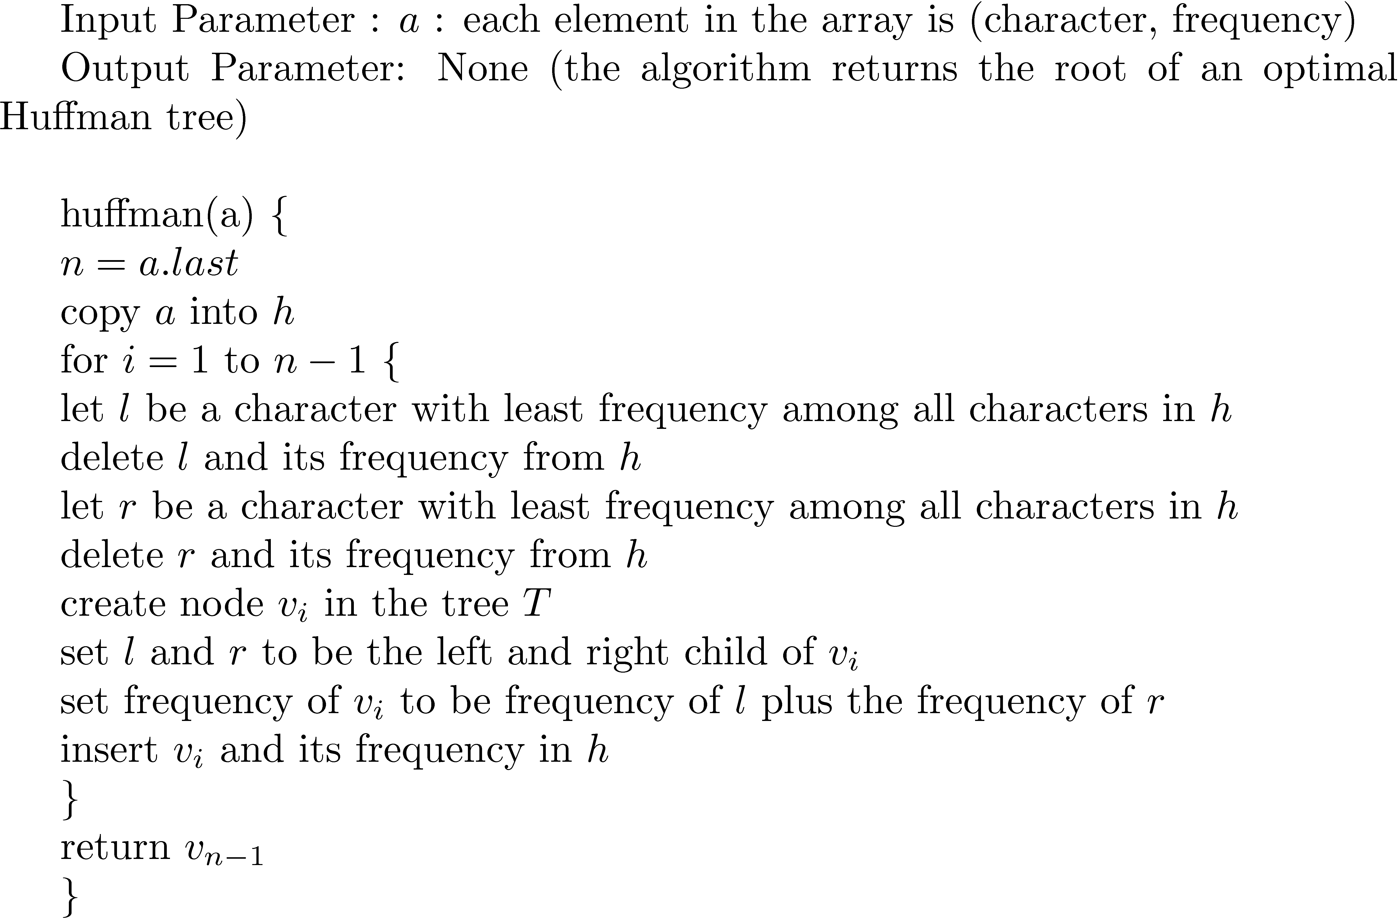
Huffman’s Algorithm
Time : Since each operation in the loop can be done in O(log n) total time is O(n log n).

Slide 62
Proof of correctness
Claim-1 : Let f₁ and f₂ be two least frequencies in (f₁, f₂, … , f_{n}). We show there exists an optimal Huffman tree in which f₁ and f₂ must be at the lowest level and also be siblings of each other.
Proof: Let T be an optimal Huffman tree. Let f₁ not be at the lowest level in T. Let f be at lowest level. Let p₁ be the path length of f₁ and let p be the path length of f in T. Then p ≥ p₁ and f ≥ f₁.
Let T₁ be a tree such that f and f₁ are swapped in T. Then
wpl(T₁) = wpl(T) - pf - p₁f₁ + pf₁ + p₁f
= wpl(T) – (p – p₁)(f – f₁) ≤ wpl(T)
Hence T₁ is also an optimal Huffman tree.
Now if f₂ is not sibling of f₁ in T₁, swap the sibling of f₁ with f₂ to get tree T₂. By doing previous arguments we can say that T₂ is also an optimal Huffman tree.

Slide 63
Proof of Correctness
Claim-2 : Let T_{A} be the tree output by Huffman’s algorithm. T_{A} is an optimal Huffman tree.
Proof: The proof is by induction on n.
Base case : n = 2 : Is easily seen since there is only one Huffman tree in this case.
Let n > 2. Let T₂ be an optimal Huffman tree as in Claim-1. Consider T₂’ with f₁ and f₂ deleted in T₂ and the parent assigned frequency f₁ + f₂. Note that
wpl(T₂’) = wpl(T₂) – f₁ – f₂. Hence T₂’ must be optimal for (f₁+ f₂, f₃, … , f_{n}).
Let T_{A}’ be with obtained from T_{A} with f₁ and f₂ deleted and the parent assigned frequency
f₁ + f₂. Then we have wpl(T_{A}’) = wpl(T_{A}) – f₁ – f₂. Note that T_{A}’ is the output of the algorithm for frequencies (f₁+ f₂, f₃, … , f_{n}).
By induction hypothesis for n-1, wpl(T_{A}’) = wpl(T₂’). Hence
wpl(T_{A}) = wpl(T_{A}’) + f₁ + f₂ = wpl(T₂’) + f₁ + f₂ = wpl(T₂).
Hence T_{A} is an optimal Huffman tree.

Slide 64
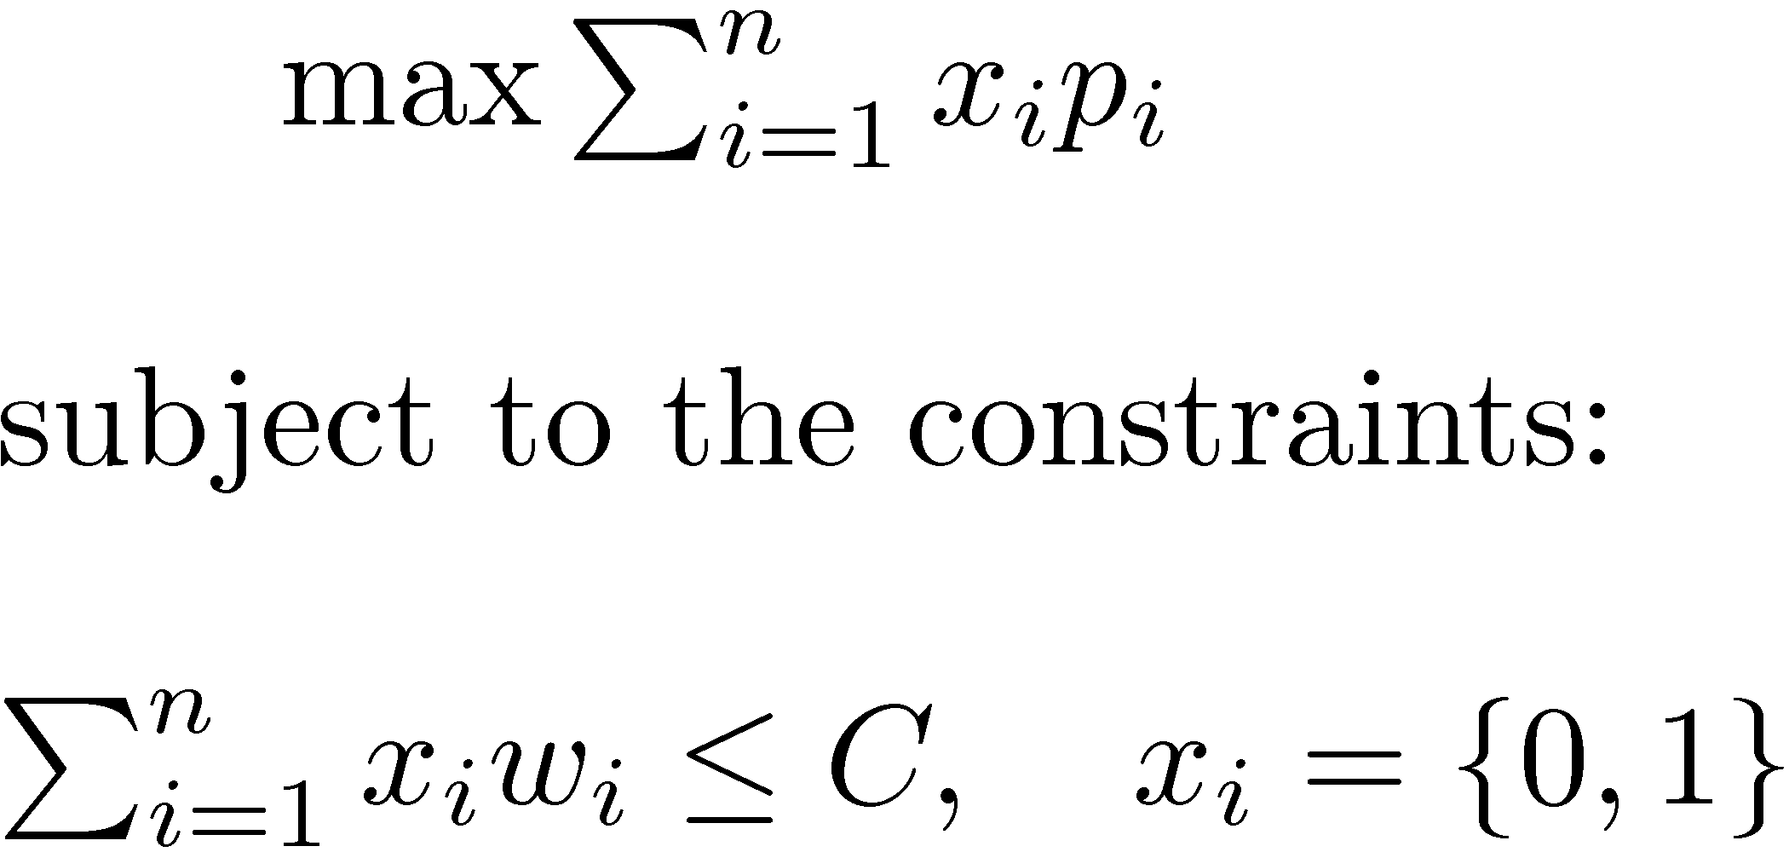
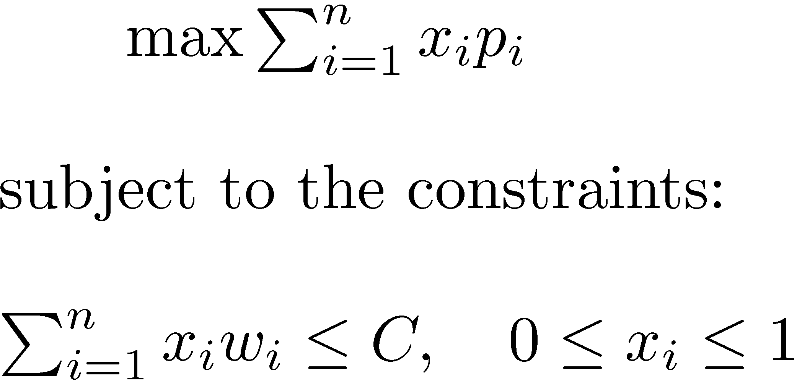
The Continuous-Knapsack problem
The 0/1 knapsack problem
The continuous knapsack problem
Idea of the algorithm for continuous knapsack problem: Greedy approach
Sort p_{i}/w_{i} in the non-increasing order.
Include objects in this order till your capacity C is exhausted.

Slide 65
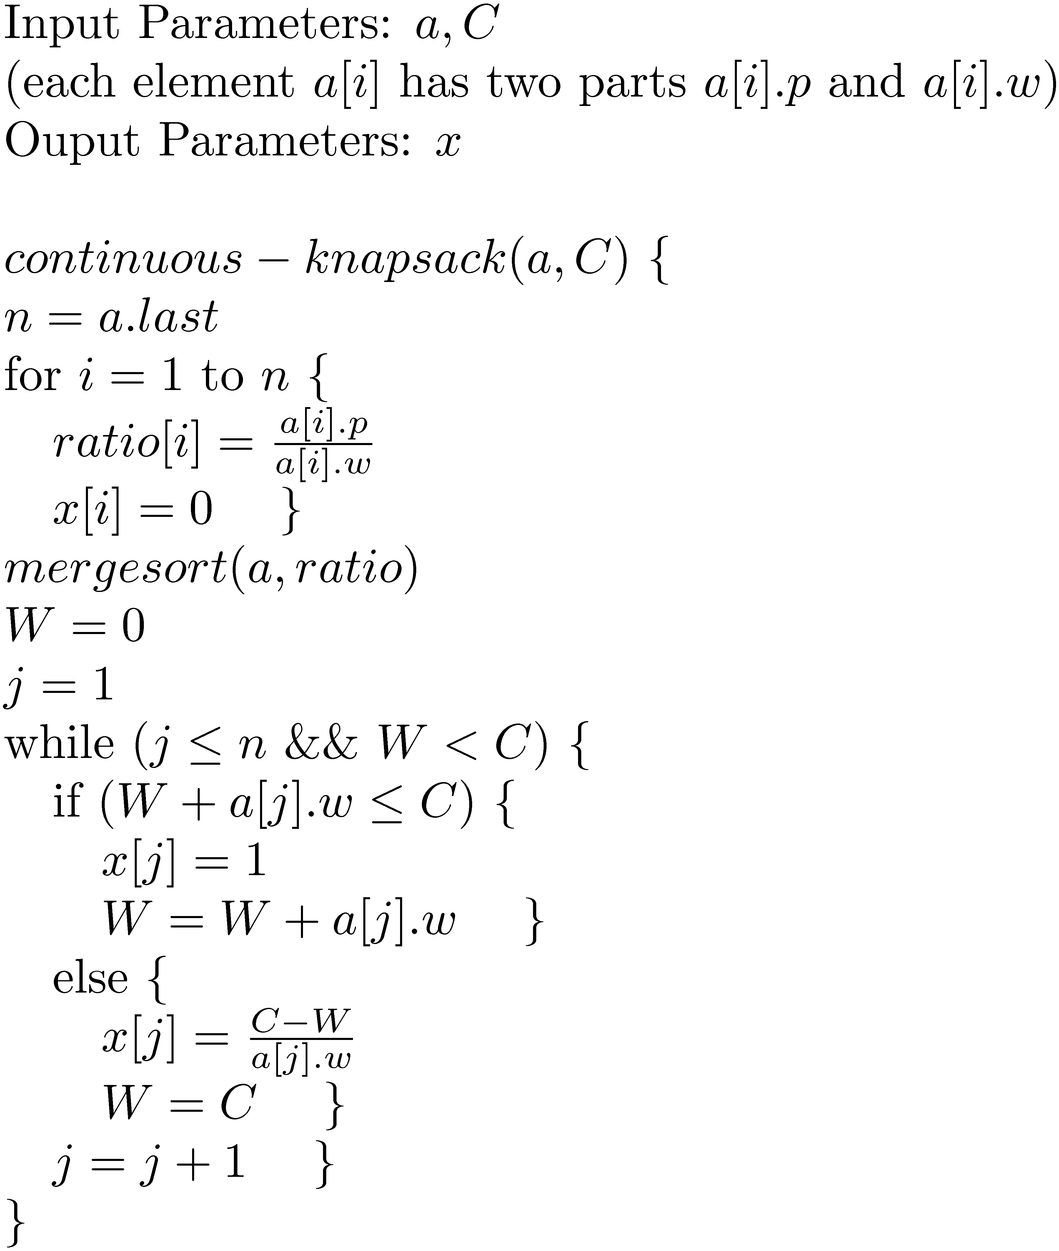
The Continuous-Knapsack problem
Time Analysis:
While loop runs in time θ(n) and sorting takes time θ( n log n ), hence overall time is θ( n log n ).

Slide 66
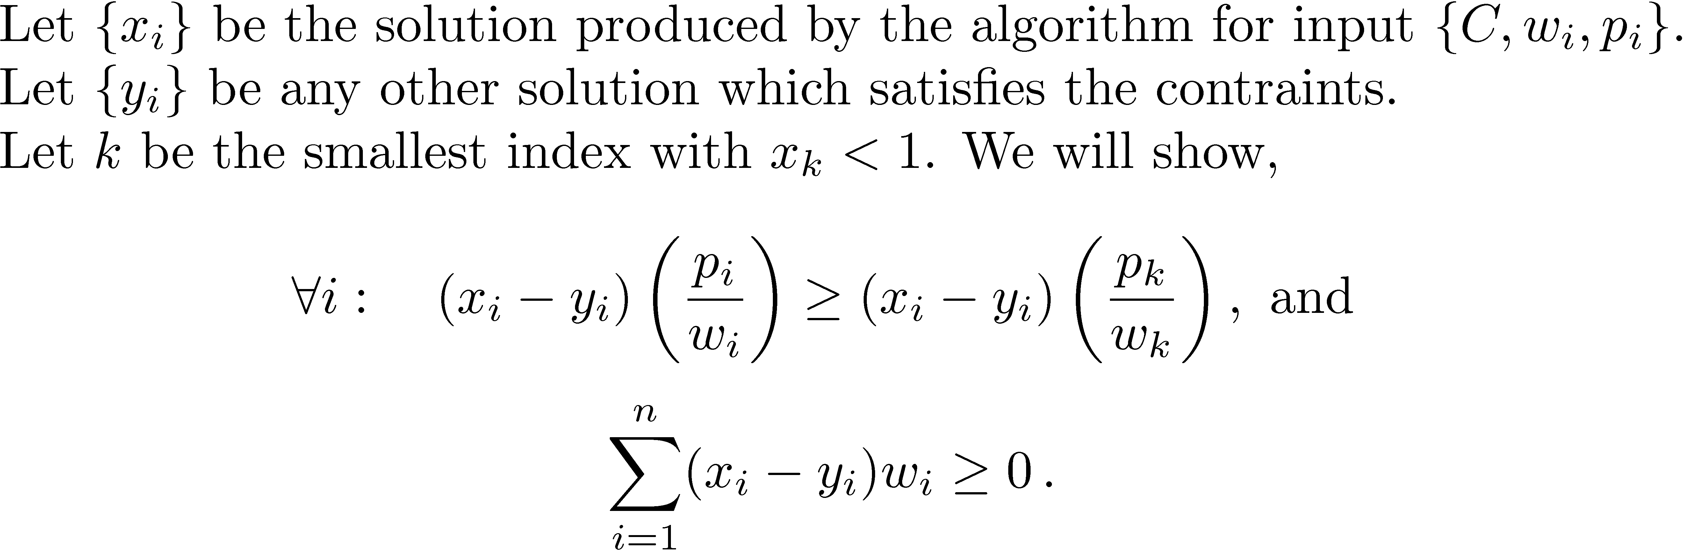
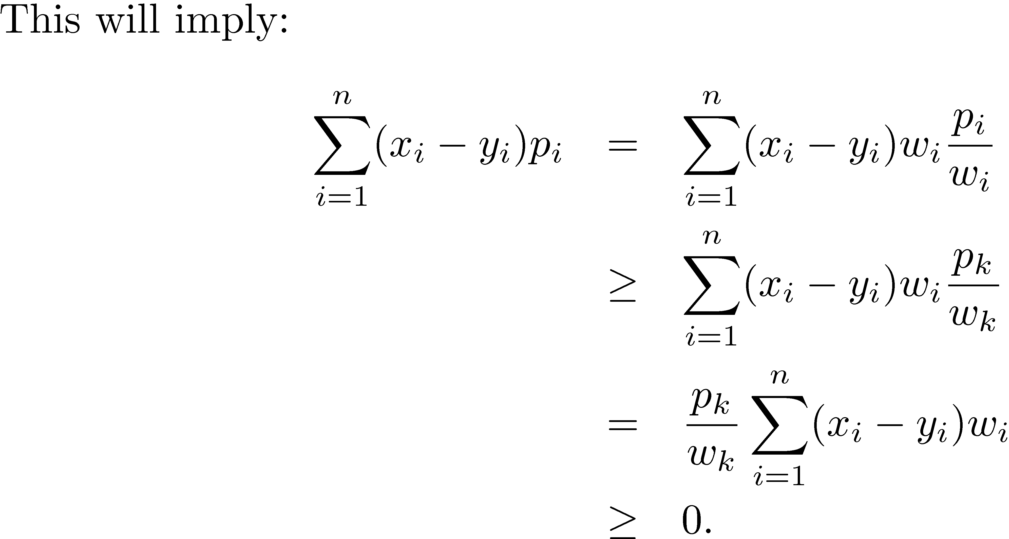

Correctness

Slide 67


Correctness

Slide 68
Applications in real life ?
Dijkstra shortest path algorithm for google maps.
Sorting for library, dictionary
Searching for internet websites

Slide 69
Dynamic Programming

Slide 70
Basic of dynamic programming
In order to solve the big problem solve sub-problems first.
The difference with Divide-and-Conquer is that in this case it is not clear which sub-problems should be solved.
Therefore in dynamic programming all sub-problems that might be needed are solved.
First the simplest sub-problems are solved and then the more complex ones are solved, all the way up to the original problem.
The results of the sub-problems are stored in a table and used later whenever needed.

Slide 71


Computing Fibonacci Numbers
Very inefficient. f₁ , f₂, f₃ etc. are calculated exponentially many times.
Time : θ(2^{n})
Efficient : Time is θ(n)
This is an example of a dynamic program.

Slide 72


Memorized recursive algorithm
Time : θ(n)

Slide 73

Coin-changing revisited
Idea : Let c_{i, j} represent the minimum number of coins of denominations denom[i] to denom[n] needed to get amount j.
Start with c_{n, j} = j for all j from 0 to A. Iteratively calculate by running i from n-1 downto 1 and j from 0 to A:
c_{i, j} = min{c_{i+1, j} , 1 + c_{i, j-denom[i]}}
The idea is that for finding c_{i,} _{j}, either
you use denom[i] in which case c_{i, j} = 1 +c_{i, j-denom[i]}
or you do not use denom[i] in which case c_{i, j} = c_{i+1, j}
Time : θ(n A)

Slide 74
Optimal substructure property
If S is an optimal solution to a problem, then the components of S are optimal solutions to subproblems.
For a dynamic-programming algorithm to solve an optimization problem correctly, the optimal substructure property must hold.
This property holds for coin-changing problem.
This property does not hold for longest-simple-path problem : For a connected weighted graph, and vertices (v,w), find the longest simple path from v to w.

Slide 75

Midterm Answer 1

Slide 76







Midterm Answer 2

Slide 77












Midterm Answer 2

Slide 78


Midterm Answer 3
Time : While loop will take time O(n) and mergesort will take time θ(n log n). Hence total time is θ(n log n).

Slide 79

Midterm Answer 3

Slide 80

Midterm Answer 4
Median(a,b)
Set n to be the number of elements in a (also in b).
If n = 1
If a[1] ≥ b[1], then return b[1]
Otherwise return a[1].
If a[n/2] ≥ b[n/2]
Then note that
a[n/2] ≥ Median(a U b) ≥ b[n/2+1]
The problem now reduces to size n/2 and then we can proceed similarly.
5. If a[n/2] < b[n/2]
Then note that a[n/2+1 ] ≤ Median(a U b) ≤ b[n/2]
2. The problem now reduces to size n/2 and then we can proceed similarly.
Time : With each iteration of the while loop, the difference between j and i (similarly the difference between l and k) reduces by factor of 2. Hence while loop can run log n times. Hence overall running time is O(log n).

Slide 81

Optimal Matrix Multiplication
Need to multiply matrices by using least number of scalar multiplications.
Idea : Let s[i,j] represent the minimum number of scalar multiplications needed to multiply ith matrix through jth matrix.
The idea is that to find s[i,j] you check for groupings (i,k) and (k,j) for all k between i and j; one of them must be optimal, so take their minimum.
Start with s[i,i]= 0 for all i. Iteratively calculate by increasing w from 0 to n-1 and increasing i from 1 to n-w :
s[i,i+w] =
min_{k}{s[i,k] + s[k+1,i+w] + size[i-1]size[k]size[i+w]}
Time : θ(n³)

Slide 82
The longest common subsequence problem
Given two sequences a[1], …, a[m] and b[1], ….b[n]
find a subsequence a[i₁], …, a[i_{k}] of a[1], …, a[m]
and find a subsequence b[j₁], …, b[j_{k}] of b[1], …, b[n]
such that a[i₁] = b[j₁] , …, a[i_{k}] = b[j_{k}].
The task is to maximize k.
Example : For
a , b , c, d, e, f and a, e, c, f, d, g, p
A longest common subsequence is (a, c, d). Another is (a,c,f).

Slide 83

The longest common subsequence problem
Idea : Let c[i][j] be the length of a longest common subsequence of
a[1], …, a[i] and b[1], …, b[j]
for i = 0, …, m and j=0, …, n.
The idea is that if a[i]=b[j] then a[i] appears in a longest common subsequence, otherwise a longest common subsequence needs to be found in
a[1] … a[i-1] and b[1] … b[j]
Or
a[1] … a[i] and b[1] … b[j-1]
Start with c[i][0] = 0 for all i and c[0][j]=0 for all j. Iteratively calculate by increasing i from 1 to m and increasing j from 1 to n:
If a[i] != b[j] then
c[i][j] = max{c[i-1][j] , c[i][j-1]}
else
c[i][j] = 1+ c[i-1][j-1] .
Time : θ(mn)

Slide 84
Floyd’s algorithm for All Pairs Shortest Paths
We want to find shortest paths between all pairs of vertices in a simple, undirected, weighted graph G. We are given matrix A (as a two dimensional array), such that A[i][j] is the weight of the edge (i,j), if there is edge (i,j). Otherwise A[i][j] is ∞ .
Idea: Let A^{k} represent the matrix such that A^{k}[i][j] is the length of a shortest path from i to j, where the intermediate vertices allowed is {1,2, …, k}.
Initially A⁰ = A, when no intermediate vertex is allowed.
Assume we have computed A^{(k-1)}. Then to compute A^{k}[i][j] :
If k appears in a shortest path between i and j with intermediate allowed vertices being {1, …, k}, then
A^{k}[i][j] = A^{(k-1)}[i][k] + A^{(k-1)}[k][j]
If k does not appear in a shortest path between i and j with intermediate allowed vertices being {1, …, k}, then
A^{k}[i][j] = A^{(k-1)}[i][j]

Slide 85

Floyd’s algorithm for All Pairs Shortest Paths
In the algorithm below, at the end A[i][j] is the length of a shortest path between i and j. Also next[i][j] is the vertex after i, in a shortest path from i to j.
Time : θ(n³)

Slide 86
Warshall’s Algorithm
We are given a simple, undirected, weighted graph G. We want to find for all pairs of vertices, if they are connected or not? We are given adjacency matrix A (as a two dimensional array), such that A[i][j] is 1 if there is an edge (i,j); otherwise A[i][j] is 0 .
Idea: Let A^{k} represent the matrix such that A^{k}[i][j] =1 if there is a path from i to j, where the intermediate vertices allowed is {1,2, …, k} (otherwise A^{k}[i][j] =0).
Initially A⁰ = A, when no intermediate vertex is allowed.
Assume we have computed A^{(k-1)}. Then to compute A^{k}[i][j] :
If k appears in a path between i and j with intermediate allowed vertices being {1, …, k}, then
A^{k}[i][j] = A^{(k-1)}[i][k] AND A^{(k-1)}[k][j]
If k does not appear in a path between i and j with intermediate allowed vertices being {1, …, k}, then
A^{k}[i][j] = A^{(k-1)}[i][j]

Slide 87


Warshall’s Algorithm
In the algorithm below, at the end A[i][j] =1 if there is a path between i and j.
Time : θ(n³)

Slide 88
P and NP (warning: NP is NOT ‘not P’)

Slide 89
Decision problems and Function problems
A decision problem L is a set of binary strings.
An algorithm A is said to accept an input string x, if A(x) = 1 .
(A(x) represents the output of the algorithm A on input x).
An algorithm A is said to reject an input string x, if A(x) = 0.
Algorithm A is said to decide L if A(x) =1 for all x in L and A(x) = 0 for all x not in L.
e.g. Graph connectivity problem : L is the binary encodings of graphs that are connected.
Function problems: Algorithm needs to compute a function f(x), given input x.
e.g. Factoring problem: Given a natural number, output smallest divisor greater than 1.

Slide 90
P (for polynomial time)
We say that algorithm A is a polynomial time algorithm if there exists constants k, c, such that on all inputs x, A outputs A(x) within time c |x|^{k} (and uses at most c |x|^{k} binary cells of memory).
We say a decision problem L can be decided in polynomial time if there is a polynomial time algorithm A that decides L. We define:
P = {L | L can be decided in polynomial time}.
Theorem: Let A and B be polynomial time algorithms. Let C be an algorithm that is composition of A and B, that is C(x) = A(B(x)); C first run B on input x and then runs A on input B(x). Then C is also polynomial time algorithm.
Proof:
When B runs on input x, it takes time at most d₁ |x|^{k1} (where d₁ , k1 are some constants).
When A runs on input y, it takes time at most d₂ |y|^{k2} (where d₂ , k2 are some constants).
Therefore when C runs on input x, it takes time at most d₁ |x|^{k1} to produce B(x) and then takes time at most d₂ (d₁ |x|^{k1})^{k2} (since |B(x)| ≤ d₁ |x|^{k1} ) to produce A(B(x)). Hence total time taken by C is at most d₃|x|^{k3} (where d₃ , k3 are some constants).

Slide 91
P
The issue related to encodings:
Let L₁ = {1^{p} (unary encoding): p is a prime}; L₁ can be decided in polynomial time. Just check for all number n, between 1 and p, if n divides p.
Let L₂ = {p (binary encoding): p is a prime}; we do not know if L₂ can be decided in polynomial time. The algorithm above takes exponential time.
Theorem: Let L, a set of binary strings, be decided in polynomial time.
Let L_{t} = {t-ary encoding of x | x in L}. Then L_{t} can be decided in polynomial time, for any t > 2.
Proof: Let A be a polynomial time algorithm for deciding L. Let B be a polynomial time algorithm which converts any t-ary string to equivalent binary string.
Then define C(x) = A(B(x)). By a previous theorem C is also polynomial time. Also C decides L_{t} .

Slide 92
Nondeterministic Algorithms
A nondeterministic polynomial time algorithm M.
M(x) {
\\ guess a witness string w_{x} of length polynomial in |x|
guess w_{x}
\\ V is a polynomial (in |x|) time algorithm
Output V(x,w_{x})
}
We say that a problem L is decided by M if the following two conditions hold:
If x is in L, then there exists a w_{x} such that V(x,w_{x}) = true .
If x is not in L, then for every string w_{x}, V(x,w_{x}) = false.
We say that L can be decided in nondeterministic polynomial time if L can be decided by a nondeterministic polynomial time algorithm M. We define:
NP = { L | L can be decided in nondeterministic polynomial time } .
Since every deterministic polynomial time algorithm is also a nondeterministic polynomial time algorithm (where there are no guesses), it implies P is subset of NP.

Slide 93
Some problems in NP
Graph-Corolaribity = { <G,k> | G can be colored using k colors such that no two adjacent vertices get the same color}
Graph-Coloroability (x) {
if x is not a valid encoding of a graph and a number
return false
else
let x = <G=(V,E),k>
// guess a color for each vertex
for each v in V
guess the color c[v]
// check that the coloring is valid
for each v in V
if (c[v] not in {1,2,…k})
return false
for each v in V
// N(v) is the neighbors of v
for each w in N(v)
if (c[w] == c[v])
return false
return true
}
Time : O(|V| + |E|), hence nondeterminitic polynomial time.

Slide 94
Some problems in NP
Hamiltonian-Cycle = { < G > | G has a cycle which touches all vertices exactly once}
Hamiltonian-Cycle (<G>) {
// G = (V,E), V= {1,2,…n}
n= |V|
// guess the sequences of vertices that will appear in a Hamiltonian Cycle
guess v₁, v₂, …, v_{n}
// check only edges in G are used
// check that all vertices are visited
for i = 1 to n
visited[i] = false
for i = 1 to n
visited[v_{i}] = true
if (v_{i}, v_{i+1}) is a not an edge in G
return false
for i = 1 to n
if (visited[i] = false)
return false
return true
}
Time : O(|V|), hence nondeterminitic polynomial time.

Slide 95
Some problems in NP
Traveling Salesperson (TSP) = { < G,w > | G is a weighted graph with Hamiltonian cycle of weight at most w}
TSP(<G,w>) {
// G=(V,E), V = {1,2,…n}
n= |V|
// guess the sequences of vertices that will appear in a Hamiltonian Cycle
guess v₁, v₂, …, v_{n}
if v₁, v₂, …, v_{n} is a not Hamiltonian cycle
return false
// check that the total weight of the cycle is at most w
t = 0
for i = 1 to n-1
t = t + weight(v_{i} , v_{i+1})
if (t > w)
return false
return true
}
Time : O(|V|), hence nondeterminitic polynomial time.

Slide 96
Exponential time
We say that algorithm A is an exponential time algorithm if there exists constants k, c, such that
on all inputs x, A outputs A(x) within time c 2^{|x|k} .
We say a decision problem L can be decided in exponential time if there is an exponential time algorithm A that decides L. We define:
EXP = {L | L can be decided in exponential time}
Theorem : NP is a subset of EXP .
Proof : Any L be in NP. Consider a nondeterministic polynomial time algorithm for L. It is of the form:
NPalgoforL(x) {
guess w_{x} of length c₁|x|^{k1}
// V is a polynomial time algorithm running in time c₂|x|^{k2}
return V(x,w_{x})
}
EXPalgoforL(x) {
for all w_{x} of length at most c₁|x|^{k1}
if (V(x,w_{x}) = true)
return true
return false
}
EXPalgoforL(x) runs in time O(c₂|x|^{k2} 2^{c1|x|k1} ) = c₃ 2^{|x|k3}. Hence L is in EXP.

Slide 97


Reducibility

Slide 98



NP Completeness

Slide 99



Boolean formula

Slide 100


Cook-Levin Theorem – First NP-complete problem
3-SAT is NP-complete

Slide 101




Reduce SAT to 3-SAT

Slide 102


Independent set is NP-complete

Slide 103


Clique is NP-complete

Slide 104

Graph 3-colorability is NP-complete

Slide 105
A few other NP-complete problems
Hamiltonian-Cycle = { < G > | G has a cycle which touches all vertices exactly once}
Traveling Salesperson (TSP) = { < G,w > | G is a weighted graph with Hamiltonian cycle of weight at most w}
Many other real world problems arising from Networks, Packing, Scheduling, Graphs, Cryptography, Games, Computational Biology etc. are NP-complete. Very little hope for finding polynomial time algorithms for these!

Slide 106
Algorithms for NP-complete problems

Slide 107

Approximation Algorithms
Bin Packing
Input : Sizes s[1], s[2], …, s[n] ϵ (0,1].
Output: Minimum number of bins (each of capacity 1) in which these objects can be packed.
next-fit(s) {
n = s.last
k = 1 // current bin
c[k] = 0 // capacity filled till now in current bin
for i = 1 to n
if (c[k] + s[i] ≤ 1 ) {
b[i] = k
c[k] = c[k]+ s[i]
}
else {
k = k + 1
b[i] = k
c[k] = s[i]
}
return k
}

Slide 108
Wigderson Coloring
Theorem : A 3-colorable graph can be colored in polynomial time using at most O(√n) colors.
Input : A 3-colrable graph G = (V,E)
Ouput : A valid coloring using O(√n) colors.
Wigderson-coloring(G) {
n = |V|
c= 0 // c is color count
while (V contains a vertex of degree at least √n) {
pick v of degree at least √n
G’ = (N(v), E)
two-color(G’, c) // this colors G’ using two colors c +1 and c +2
c= c +2 // move to the next set of colors
G = G – N(v)
}
S = {c, c+1, …. , n}
for each v in V
color v with smallest color in S not used by any vertex in N(v)
}

Slide 109
Brute Force
Largest Independent Set
Input : Graph G=(V,E)
Output: None
Largest-independent-set(G) {
if (E is empty)
return |V|
else {
pick first v in V such that N(v) is not empty
G₁ = G – {v}
G₂ = G – {v} – N(v)
k₁ = largest-independent-set(G₁) // assume v is not in independent set
k₂ = largest-independent-set(G₂) // assume v is in independent set
return max(k₁, k₂ +1)
}
}
Let a_{n} be the running time. Then
a_{n} = a_{n-1} + a_{n-2} + cn²
Solving this recursion gives
a_{n} = O(1.62^{n})

Slide 110
Brute Force
3-SAT
Input Parameter : 3-CNF formula φ
Ouput : None
3-satisfiability(φ) {
if (φ does not contain any clauses)
return φ // φ has to be logical constant either true of false
if (φ contains a clause with one literal a) {
φ₁ = φ[a->true] // a has to be true
return 3-satisfaibility(φ₁)
}
if (φ contains a clause with two literals a and b) {
φ₁ = φ[a->true]
φ₂ = φ[a->false][b->true]
return 3-satisfaibility(φ₁) ) || 3-satisfaibility(φ₂)
}
if (φ contains a clause with three literals a, b and c){
φ₁ = φ[a->true]
φ₂ = φ[a->false][b->true]
φ₃ = φ[a->false][b->false][c->true]
return 3-satisfaibility(φ₁)
|| 3-satisfaibility(φ₂)
|| 3-satisfaibility(φ₃)
}
}
Let a_{n} be the number of recursive calls made by the algorithm on input formula with n variables. Then
a_{n} = a_{n-1} + a_{n-2} + a_{n-3}
Solving this recursion gives
a_{n} = O(1.84^{n}). In each recursion the time taken is O(|φ|) and hence total time taken is
O(|φ| 1.84^{n}) .
The best time known till now is O(|φ| 1.77^{n}) due to Dantsin, Goerdt, Hirsch and Schoning.

